Slide 1
Cross-Layer Dataset Design and Exploratory Analysis of an ESP32-Based ESP-WIFI-MESH Network
Thesis 3 final defense | NIS16
Calpoporo, Jose Angelo C. · Carlos, Miguel Sebastian C. · Ong, Kyle Edward M. · Reinante, Christian Victor G.
Adviser: Mr. Gregory G. Cu | College of Computer Studies, De La Salle University
Notes:
KEY FACTS
- Team NIS16; adviser Mr. Gregory G. Cu
- Flow of the talk: Chapters 1 to 3 in brief; Chapters 4 and 5 together as "planned vs. actual"; most of the time on Chapters 6 and 7
- One-line summary: 8 ESP32 boards, two attacks emulated at the application layer, 80 runs, every run checked before it counts

Slide 2
The thesis in one slide
1
What we built
2
What we checked
3
What we found
8 ESP32 boards: 1 root + 7 children
Blackhole and wormhole, emulated at the application layer
4 topologies × 3 sites × 3 scenarios: 80 runs
A verifier tests every run before it enters the dataset
Both attacks confirmed in 72 of 72 attack runs
No attack signature in 8 of 8 benign runs
Blackhole: visible through delivery (PDR)
Wormhole: visible through duplicate arrivals at the root
Radio and routing features did not move
Both attacks left a clear, verified mark on the traffic, but not on the radio or routing features, because they were emulated at the application layer.
Notes:
KEY FACTS
- Say the answer first; the rest of the talk shows how we got it
- 80 runs = 36 blackhole + 36 wormhole + 8 benign
- Verifier result: all 72 attack runs confirmed (67 complete, 5 minor gaps); all 8 benign runs confirmed benign
- Main reading (Ch 6 and 7): the attacks live in the data plane (delivery, duplication), not across layers
- The paper treats "cross-layer features did not respond" as a finding, not a failure
SOURCE: Sections 7.3 and 7.4

Slide 3
Chapters 1 to 3, in brief
1-3
The gap, the objectives and the predictions we wrote before any data

Slide 4
The gap and the objectives
The gap (Chapters 1 and 2)
General objective
Simulated data: Most IDS datasets come from simulators or IP networks (KDD, NSL-KDD), not from mesh hardware
Design, generate and analyse a cross-layer dataset from an ESP32 mesh to explore how normal operation differs from controlled attacks.
1
Missing layers: Packet or flow datasets do not hold PHY, MAC and network signals of a microcontroller mesh together
Specific objectives
2
1
Build an ESP32 mesh testbed with normal and attack traffic
Real attacks: Blackhole and wormhole detection is mature in simulation; on real ESP32 boards it is undocumented
3
Collect PHY, MAC and network features into a labelled dataset
2
This study: a labelled, cross-layer dataset from a real ESP-WIFI-MESH network under normal operation and two controlled attacks. Setting: indoor campus monitoring, as in Khan et al. (ESP32 mesh, delivery above 97%).
3
Evaluate it with EDA and unsupervised clustering
Scope: a dataset and its exploratory analysis, not an intrusion detection system.
Notes:
KEY FACTS
- WMN: every node is host and router; one misbehaving relay can break delivery for everyone behind it
- Ring et al. surveyed IDS datasets: packet- or flow-based, not cross-layer, not microcontroller mesh
- Khan et al. [22]: ESP-MESH on a campus, delivery above 97%; our smart-campus scenario follows them
- Labelled attack data is scarce in IoT, so EDA and unsupervised clustering instead of a supervised classifier
- Objectives are unchanged from the approved proposal (Section 1.3.2)
- Scope (1.4): two attacks, 8 boards, 3 indoor sites, isolated mesh, no detection-accuracy claims
IF ASKED
- Why no IDS? The objectives are dataset + EDA + clustering; a detector needs the dataset first. Recommendation 5 in Ch 7 covers how to evaluate one
SOURCE: Chapters 1 and 2

Slide 5
The theory: an attack breaks a relationship
Normal mesh traffic keeps cross-layer relationships (Table 3.7). We wrote down which ones each attack should break before any capture (Tables 3.4 and 3.5).
Relationship
Under normal operation
Prediction written before any data
Received ≈ forwarded
Every relay passes on what it gets
Blackhole: ForwardingRatio < 1 at the attacker; victims' PDR falls; victims retransmit more
One copy per probe
Each probe reaches the root once, by one path
Wormhole: duplicate arrivals at the root
Delay follows hops
Deeper nodes take longer to reach the root
Wormhole: latency mismatch between the two copies
Placement fits topology
Parent layer < child layer; signal weakens with depth
Wormhole: low hop counts, impossible parent links, RSSI that does not fit the depth
Chapter 6 tests every row. The tables were kept as written, so the panel can see what was predicted and what was found.
Notes:
KEY FACTS
- Blackhole breaks reception -> forwarding (receives, does not forward)
- Wormhole breaks physical placement -> logical topology (a tunnel makes far nodes look close)
- Features are ratios and mismatches so they measure the broken relationship, not a raw value that changes by site
- Chapter 6 outcome: the traffic-level predictions held (duplicates, latency mismatch, PDR, ForwardingRatio); retransmissions and every topology and RSSI prediction did not
- Why emulation (Section 3.5.3): the ESP32 Wi-Fi stack is closed; an app can read the routing table but cannot write it
SOURCE: Tables 3.4, 3.5, 3.7; Section 3.5

Slide 6
Chapters 4 and 5: planned vs. actual
4-5
How a run works, how both attacks are built, how every run is checked, and the 37 places where we changed the plan

Slide 7
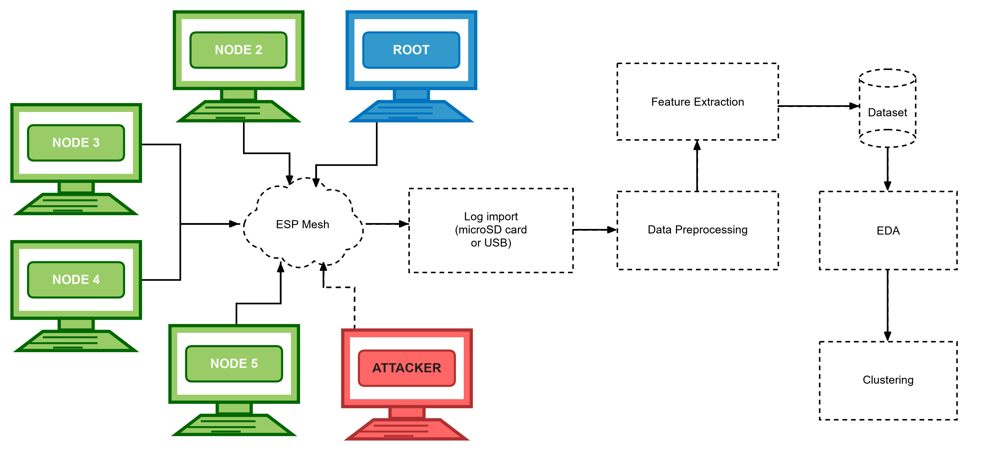
How one run works
Formation
≥ 60 s
Baseline
300 s
Attack
180 s
Cooldown
120 s
→ End
label 255, excluded
label 0 (normal)
label 1 blackhole / 2 wormhole
label 0 (normal)
Every board logs at 10 Hz to flash and a microSD card
Logs are imported after the run; nothing is streamed over the mesh, so an attack cannot erase its own evidence
The root drives the phases: 5 rounds, 100 ms apart, repeated every 10 s
The attack starts only after the pre-run gates pass and the operator types START (D-22)
Labels come from the phase schedule, never from a feature
Figure 4.1. Read left to right: boards → ESP mesh → log import → preprocessing → features → dataset → EDA and clustering. Red board = attacker; dashed boxes = processing steps.
Notes:
KEY FACTS
- Phase IDs: 254 formation, 0 baseline, 1 blackhole, 2 wormhole, 3 cooldown, 4 terminate; a run uses phase 1 or 2, never both
- Root = referee: receives every probe, logs every arrival, drives the phases; a session ID tells a restarted root from a repeat
- Probe = tiny app packet: magic, sequence number, send time, source MAC; every 1000 ms (stationary, burst) or 250 ms (highload)
- Gates (D-22): every child joined; tree blackhole attacker has a child; wormhole has one A and one B, UART works, A shallower
- A failed gate locks START (D-24); override needs a typed reason, logged and reported
- Sniffer laptop outside the mesh = independent witness (optional)
IF ASKED
- Why label 255 for formation? Rows outside the experiment can be excluded by value instead of by time
SOURCE: Table 4.1, Figures 4.1 to 4.3, Section 4.1

Slide 8
Two attacks, emulated at the application layer
Blackhole: forwarding suppression
Wormhole: out-of-band tunnel
A placed relay runs the same relay code as every node
In the attack phase it stops forwarding (no esp_mesh_send() call)
It still ACKs every frame at the link layer, so victims see no failure
UART wire, 115200 baud, 30-byte frames with CRC32
End B (deeper) also writes its own probes into the wire; end A (shallower) re-injects them toward the root
The root gets every B probe twice, by two paths, with different delays
✓
4 of 5 criteria of Airehrour et al. [70] met
✓
4 of 5 criteria of Hu, Perrig and Johnson [46] met
✗
Not met: attracts traffic with a false route
✗
Not met: creates a false neighbour
Why emulation (D-20): ESP-WIFI-MESH lets an app read its routing table but not write it, so both attacks reproduce the traffic effect, not the routing manipulation.
Notes:
KEY FACTS
- Blackhole: forward_decision() returns false in phase 1; the probe is dropped by omission; the attacker keeps its parent and keeps logging
- The link-layer ACK is why victims never retry or change parent (explains "retransmissions not observed" in Ch 6)
- Traffic reaches the attacker by placement, not a false route; in the star the attacker is the hub (D-16)
- Wormhole frame: "TNL1" magic + the 22-byte probe + CRC32; A changes the magic to "PROW" so the root logs it as a second arrival
- A keeps B's sequence number, timestamp and source MAC; roles set at run time by depth via a HELLO frame and locked at phase 0 (D-17)
- The wire plays the role of the GSM link in Zhukabayeva et al. [71]
- A wormhole run has no victims: only B's own probes are tunnelled; the other 5 boards are untouched
IF ASKED
- "Is it really a blackhole?" Meets 4 of 5 criteria (Table 4.4); we call it forwarding suppression and list route attraction as the first limitation
- "Is it a wormhole if the topology never changes?" Two colluding ends, out-of-band channel, capture and replay (Table 4.5); it reproduces the packet-level signature, not the false neighbour
- "Why not make the root the attacker?" The root is the destination and the referee; it would be grading itself (D-16)
- Weak spot: Table 4.4 row 1 still says victims address the attacker. Since D-12 victims send to their own parent; the tree routes them through the attacker
SOURCE: Sections 4.2.1.2 and 4.2.1.3; Tables 4.4 and 4.5; D-20

Slide 9
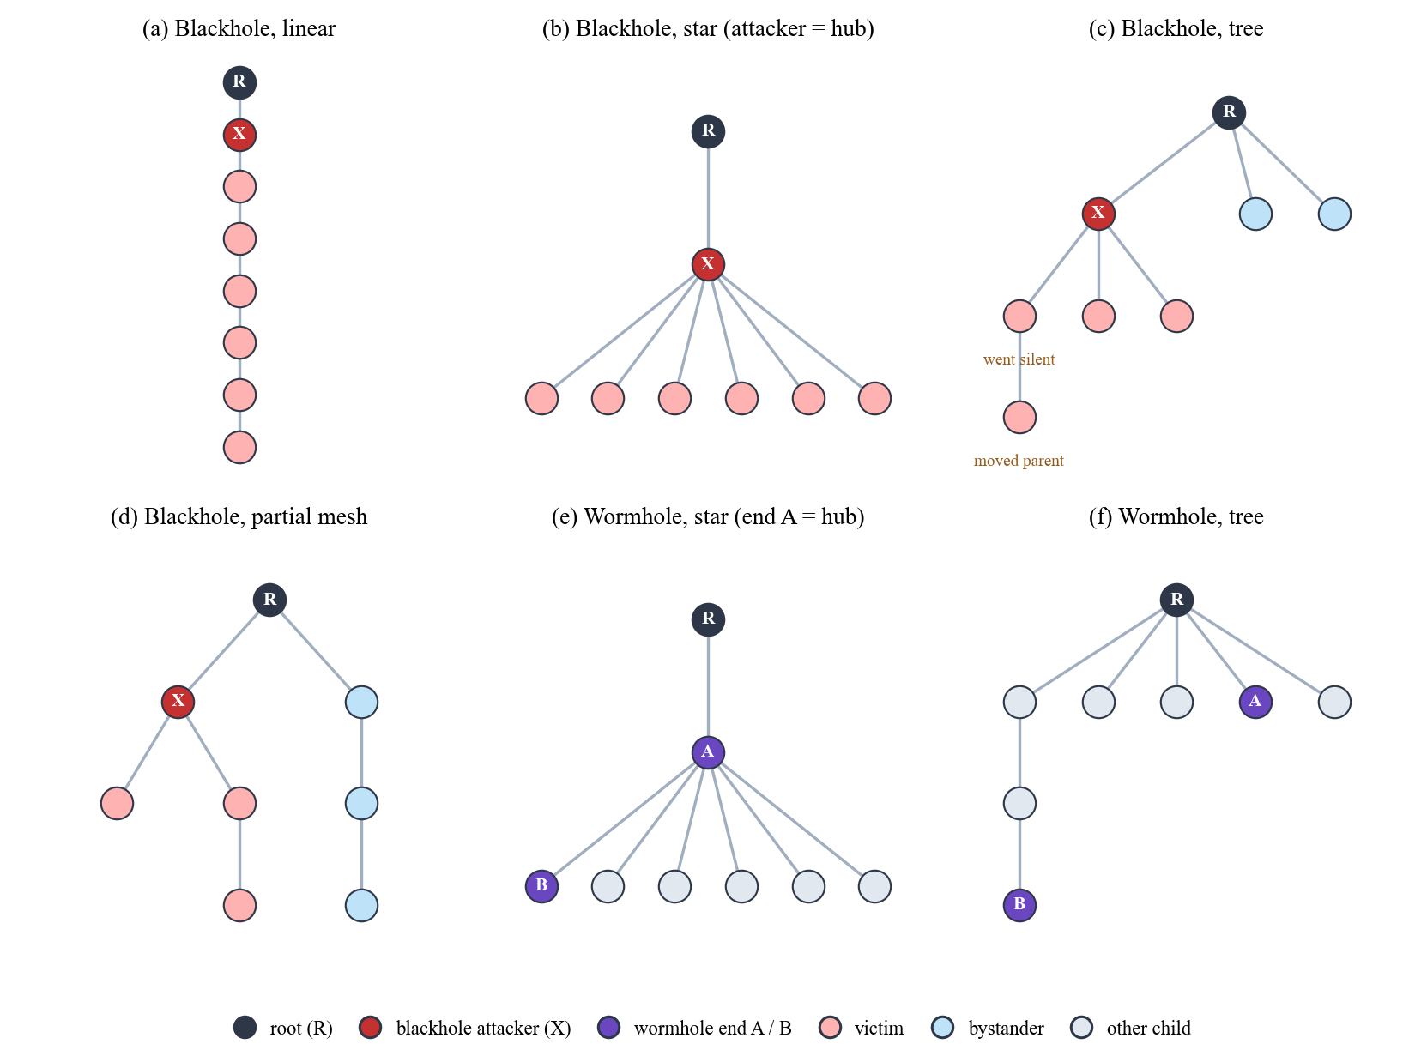
Topologies as they formed, and the run design
Three sites
G402 (GCCS): controlled classroom
DLSU Library: busy area, heavy Wi-Fi
Yuchengco Building: area within the building
Three traffic scenarios
Stationary: 1 probe per second (reference)
Burst: 300 probes, 60 s into the attack
Highload: 4 probes per second, whole run
4 topologies × 2 attacks × 3 sites × 3 scenarios = 72 attack runs
+ 8 benign runs = 80. One run per cell, so the sites act as repeats.
How to read it
Axes: Figure 4.57: each drawing is one run's tree, root (R) on top; the deeper a board, the more hops from the root.
Colours: X = blackhole attacker, A / B = wormhole ends, red = victims, blue = bystanders, grey = other boards.
Look for: The star has no bystanders (every board is behind the hub); in (f) end B sits deeper than end A.
Notes:
KEY FACTS
- ESP-WIFI-MESH always builds its own tree; a topology = board placement + an ESP-IDF option (depth cap, children limit); what formed is checked after every run
- Linear: chain, deepest hop 7. Star attack runs: root has 1 child, the hub has 6 (attacker or end A is the hub, D-16, D-28)
- Tree: root has 2 to 5 children, deepest hop 2 to 4 (D-26 sticky parents, D-37 children limit per build)
- Partial mesh: at most 2 children per node; no board ever used a second parent, so it behaved as a branched tree (D-29)
- Star has no bystanders: every board is behind the hub
- Scenarios exist so traffic volume alone cannot reveal an attack
- Hop = layer - 1, root = hop 0 (D-11)
IF ASKED
- "Is your partial mesh really a mesh?" No board used a second parent; reported as a placement-defined branched tree, no adaptive switching claimed
- "Why does the star tunnel skip only 1 hop?" A flat star puts every board at hop 1; A as hub gives the smallest real shortcut (D-28)
- Weak spot: Section 4.2.2.1 still says Figure 4.16 is "to be redrawn" and hub-star "not yet usable". The figure is redrawn and all 9 star wormhole runs are captured and confirmed
- Weak spot: 4.2.2.2 says sticky tree parents "not yet confirmed on hardware"; only 1 of 132 tree boards changed parent in the labelled phases
SOURCE: Section 4.2.2, Table 6.35, Figure 4.57

Slide 10
From raw rows to 16 features
1
Align
Boards share no clock; each is aligned to its own exit from phase 0
Forwarding
ForwardingRatio, IngressEgressDelta, ConsistencyScore
2
Window
1 s windows on a 10 Hz grid; fewer than 8 of 10 samples = discarded
Delivery
PDR (blank when nothing was sent), RetryRate
3
Fill
Gaps of 1–2 samples inside a kept window are filled
Topology
ParentSwitchRate, HopChangeCount, HopStabilityDuration
4
Count
Cumulative counters become per-window deltas
Physical
RSSI_mean, RSSI_var, RSSI_stability
Join
Delivery joins root arrivals on the sequence number, never on time
Cross-layer
RSSI_Hop_Diff, LatencyHopRatio
5
Tunnel
TunnelIntensity, TunnelBytes, TunnelLatency (ends only)
One row = one board × one second
Notes:
KEY FACTS
- Grid rule (D-25): each sample takes the earliest free 0.1 s tick, at most 300 ms late, never early
- Result: 457,568 windows formed, 1,372 discarded (0.30%); no run lost more than 1%
- Why 1 s windows of 10 samples (D-1, D-9): with 5 samples one loss costs 20% of a window; the panel asked for about 10,000 rows per run
- Side effect: about one probe per second, so one window's PDR is close to 0 or 1; PDR is read as a mean over many windows
- ForwardingRatio = forwarded / received; ConsistencyScore = |FR - 1|; IngressEgressDelta = |received - forwarded|
- PDR gets a value (even 0) only if the node sent, was attached, and the root was logging (D-8)
- LatencyHopRatio uses delay relative to the sender's fastest delivery (D-2); TunnelLatency = gap between the two copies at the root (D-3), offset cancels exactly
- RetryRate = app counters (failed sends), not MAC retries (D-15); on end B it counts tunnel frames
IF ASKED
- "Clocks aren't synchronised, so how do you get delay or delivery?" Join on sequence number; align each board to its own phase-0 exit; delay is relative (D-2)
- Weak spot: the paper text says IngressEgressDelta and RSSI_Hop_Diff are differences ("minus"); the dataset stores the absolute value of both
SOURCE: Section 4.2.4, Tables 4.17 and 6.7

Slide 11
How to read the dataset: one row
One row = one board × one second. Four real rows from the tree / G402 / stationary blackhole run (board = last four hex digits of its MAC):
# | Board | Role | When | Label | Hop | Received | Forwarded | Dropped | ForwardingRatio | PDR | LatencyHopRatio
1 | 1C38 | attacker | baseline, −100 s | 0 | 1 | 3 | 3 | 0 | 1.000 | blank | blank
2 | 1C38 | attacker | attack, +120 s | 1 | 1 | 3 | 0 | 3 | 0.000 | blank | blank
3 | D7B4 | victim | attack, +120 s | 1 | 2 | 0 | 0 | 0 | blank | 0.000 | blank
4 | 0C80 | bystander | attack, +120 s | 1 | 1 | 0 | 0 | 0 | blank | 1.000 | 6.161
1
Label = the phase
2
Blank is not zero
3
Same label, different story
Rows 1 and 2 are the same board. The label flips from 0 to 1 only because the schedule entered the attack phase; no feature decided it.
Blank = not defined: ForwardingRatio needs something received, PDR is not scored on the attacker. Row 3's 0.000 is real: probe sent, none arrived.
Rows 3 and 4 both carry label 1, but the victim's PDR is 0.000 and the bystander's 1.000. That is why no method reaches ARI 1.0 on all nodes.
Notes:
KEY FACTS
- Rows come from the windowed feature table of the tree / G402 / stationary blackhole run. Rows 2 to 4 are the same second, 120 s after the attack started; row 1 is 100 s before it. Nothing is typed by hand
- Boards: 1C38 = the blackhole attacker (hop 1); D7B4 = a victim (its parent is the attacker, hop 2); 0C80 = a bystander (its parent is the root, hop 1)
- hop = layer - 1; the root is hop 0
- Received, forwarded and dropped are per-second changes of running counters; on a relay received = forwarded + dropped (row 2: 3 = 0 + 3)
- ForwardingRatio = forwarded / received, blank when nothing was received (rows 3 and 4: received 0)
- PDR is not scored on the attacker or the wormhole ends; elsewhere it gets a value, even 0, only if the board sent in that window, was attached, and the root was logging (D-8)
- LatencyHopRatio is blank when none of the node's probes arrived in the window, because a dropped probe has no delay (row 3)
- The table has more columns (RSSI, parent address, sample counts, counter totals, phase IDs); the legend file next to it explains each one
- Cross-check: for the linear / G402 / stationary run the same table gives 1,077 received and 1 forwarded for the attacker in the attack, as in the paper
IF ASKED
- "Why is a bystander labelled attack?" The label is set by phase for every board of the run (Section 6.1); no feature of a board the attack never reached can show it, which caps the ARI at 0.515
- "Why is PDR blank for the attacker?" It is not scored on the attacker or the tunnel ends; the attacker is measured by ForwardingRatio
SOURCE: Section 4.2.4, Tables 4.17 and 6.7; feature table and its legend in the analysis folder of the run

Slide 12
Every run is validated before it counts
1
Signature
2
Topology
Testing the verifier itself
0 of 106
3-sigma test (Zhukabayeva et al. [71]): attack mean ≥ 3 baseline SDs away in the expected direction, change ≥ 0.10
Tree rebuilt from parent addresses; a board changing class during the attack fails the run
false confirmations in a placebo test (second half of the baseline relabelled as attack)
3
Dataset
4
Scenario
0
Every board covers ≥ 95% of each phase; missing boards are graded by role
Probe rate and burst timing match the scenario the run is filed under
verdicts changed when every threshold moved ±50% (53 runs, 14 settings)
An absurd setting (1,000 SDs) changed 18 verdicts, so the test can fail.
Rules fixed before any result was read. Missing data never becomes a pass or a fail.
Notes:
KEY FACTS
- 3-sigma details: 5 one-second windows pooled into one point (36 attack points); also needs at least 6 attack points
- Baseline never varied (SD = 0): any move in the expected direction passes. Broken baseline (mean < 0.90 or SD > 0.15 of mean) = primary excluded, not failed
- Primaries: blackhole = attacker ForwardingRatio + PDR of non-attacker nodes; wormhole = TunnelIntensity (ends count themselves) + DuplicateRate (root's independent view, D-21)
- Setup check: blackhole attacker relayed then dropped, victims alive but cut off; wormhole one A and one B, A shallower, wire delivered B's frames
- Parent changes in the attack tolerated if the board keeps its class (D-23); attacker re-parenting rules D-31; outcome-blind (reads only parent addresses)
- Outcomes: PASS / FAIL / INCONCLUSIVE; grades STRONG, GOOD, MINOR GAPS (kept, footnoted), MAJOR GAPS (recaptured)
- TunnelLatency and LatencyHopRatio are reported, not scored: no tunnel baseline; LatencyHopRatio |z| could never exceed 0.64
IF ASKED
- "How do you know a run is valid and not noise?" Five checks, rules fixed in advance, placebo 0 of 106, sensitivity ±50% changed nothing
- Weak spot: 4.2.7.1 calls a zero-SD z "undefined", 6.2 calls it "infinite". Safe phrasing: the baseline never varied, so any move in the expected direction passes
SOURCE: Section 4.2.7, Figure 4.55, Table 4.24

Slide 13
The 3-sigma test, in one picture
Schematic of one feature (for example ForwardingRatio) over one run, not to scale
A primary check passes when all three hold
normal range: baseline mean ± 3 SD
1
The attack mean is at least 3 baseline SDs from the baseline mean, in the expected direction
2
The absolute change is at least 0.10
Baseline: 60 points of 5 windows
≥ 3 SD away and a change of ≥ 0.10
3
There are at least 6 attack points
Example (illustrative numbers)
z = (0.003 − 1.000) ÷ 0.002 = −498.5
All three rules met. If the baseline never varies (SD = 0), any move in the expected direction passes.
Attack: 36 points, all far outside the band
Notes:
KEY FACTS
- Zhukabayeva et al. [71]: pool every 5 one-second windows into one point; a 180 s attack gives 36 points, the 300 s baseline gives 60
- z = (attack mean - baseline mean) / baseline SD
- A primary with a broken baseline (mean below 0.90 or SD above 0.15 of the mean) is excluded, not failed
- Blackhole primaries: attacker ForwardingRatio and PDR of the non-attacker nodes. Wormhole primaries: TunnelIntensity (counted by the ends) and DuplicateRate (measured at the root, independent of the attackers, D-21)
- Real runs: where z was finite (21 blackhole runs) the attacker's ForwardingRatio sat at least 22.9 SDs away, median 111; in the other 15 runs the baseline never varied
- TunnelLatency and LatencyHopRatio are reported, not scored: the first has no baseline (no tunnel then), the second's baseline is so spread that |z| could never exceed 0.64
- The example numbers are illustrative, not from one run
IF ASKED
- "With SD = 0, is any tiny change a pass?" No: the absolute change must also be at least 0.10, so one lost probe can never count as an attack
- Weak spot: Section 4.2.7.1 calls a zero-SD z "undefined", Section 6.2 calls it "infinite". Safe phrasing: the baseline never varied, so any move in the expected direction passes
SOURCE: Section 4.2.7.1, Section 6.2.1, Table 6.9

Slide 14
Chapter 5: 37 deviations, three reasons
37
1
The platform could not measure it
No MAC retry count reaches the app (D-15); probes get no reply, so no round-trip time (D-2, D-3)
documented deviations, D-1 to D-37
2
The plan would leak the label or fail to make the attack
17 modify what the proposal specified; 20 add a rule the proposal did not have. Each lists what was planned, what changed, why, and the cost (Appendix C).
Relay counters existed only on the attacker (D-12); ends at the same depth skip no hop (D-17, D-28, D-30)
3
A run needed rules to be one valid experiment
Pre-run gates and START (D-22); parent changes in the attack (D-23); missing boards by role (D-32)
Notes:
KEY FACTS
- Changes were not planned in advance: each came when a capture or review showed the plan could not be followed or would give untrustworthy data
- Five groups (Table 5.1): data collection and sampling; feature definitions; attack implementation; experimental design; run control and validation
- Several were scope decisions checked with the adviser (D-19 sites, D-33 jitter out, D-35 benign plan)
IF ASKED
- "37 deviations means you didn't follow your proposal?" Each was forced by evidence (three reasons above), each is documented with its cost, and only four limit how the results are read (next slide)
SOURCE: Sections 5.1 and 5.2, Tables 5.1 and 5.2, Appendix C

Slide 15
Planned vs. actual: the changes that matter
The proposal planned | What we did | Why
Attacks on routing (false route, false shortcut) | App-layer emulation: a placed relay drops; a wire copies probes | The API reads routes but cannot write them (D-20)
The mesh stack relays traffic out of sight | Every node relays probes itself and counts them | Only the attacker had relay counters, which leaked the label (D-12)
MAC retry count from Wi-Fi statistics | App counters kept as a column; real retries from a sniffer (7 runs) | No retry number reaches the app (D-15)
5 s windows of 5 samples | 1 s windows of 10 samples at 10 Hz | One lost sample cost 20% of a window (D-1, D-9)
Flat star; fixed wormhole ends | Hub = attacker or end A; ends chosen by depth, B deeper | Root cannot attack; equal depth skips no hop (D-16, D-17, D-28, D-30)
No benign control runs | 8 benign runs across sites and scenarios | A control for false alarms (D-18, D-35)
Limits how Chapter 6 is read (5.7): D-20 emulation, D-15 no MAC retry count, D-18/D-35 only 8 benign runs, D-37 tree fan-out differs per run.
Notes:
KEY FACTS
- D-20 is the most important limitation: no route attraction, no false neighbours, no attacker-caused parent changes in the data; this is why cross-layer features stayed flat
- D-12 answered the Thesis 2 panel objection "if one feature decides it, ML is unnecessary": before it, an empty relay column identified the attacker
- D-15: the only statistics call prints to the log and returns a status; no number reaches the app
- D-5: baseline = phase 0 of the same run, so firmware, roles and placement are identical and the attack is the only change
- Benign plan went 12 -> 9 (jitter dropped, D-33) -> 12 -> 8 (D-35); final 4 stationary, 3 highload, 1 burst; G402 4, Library 2, Yuchengco 2
- Star wormhole (D-28): normal copy B -> A -> root = 2 hops; tunnel copy = 1 hop; A also relays B's normal copy, controls are 2 hops from the root
- D-36: in tree and partial mesh the wormhole ends join as leaves; D-30: B never takes the root as parent
SOURCE: Sections 5.3 to 5.7

Slide 16
Chapter 6: Results and Discussion
6
The dataset, attack validation, EDA, clustering and what it all means

Slide 17
The dataset: 80 of 80 runs captured
80 / 80
369,678
runs: 36 blackhole, 36 wormhole, 8 benign
windows analysed (of 456,195)
0.30%
637
windows discarded (1,372)
log files, none empty
Analysed: 266,491 normal + 103,187 attack windows. Blackhole boards: 123 victims, 92 bystanders (the star has none).
How to read it
Axes: Each bar = the number of runs captured in that topology; one tick = 3 runs.
Colours: Red = blackhole, orange = wormhole, green = benign (control) runs; the number is printed on each segment.
Look for: Every topology has 9 blackhole and 9 wormhole runs; the benign runs are only 3, 3, 1 and 1 (Tables 6.1, 6.3).
Notes:
KEY FACTS
- By site: G402 28, Library 26, Yuchengco 26 runs
- Every run has 8 boards except benign star/Yuchengco/highload (6) and blackhole tree/G402/highload (7: B768 recorded nothing, a bystander)
- Window shares (Table 6.2): before baseline 85,435 (not analysed); baseline 190,423; attack 103,187; cooldown 76,068; phase boundary 1,082
- 15 earlier captures of 11 cells replaced and archived; 12 captures outside the plan (5 jitter, 7 at home) not counted
- 7 groups carry a note but are kept: e.g. linear/G402/burst blackhole burst fired outside the attack (D-34, minor gap); all 9 partial mesh runs per attack are plain trees
- Why features are often blank (Table 6.8): ForwardingRatio exists only when a node relayed something (36.3% of non-attacker windows); PDR is not scored on the attacker or tunnel ends
IF ASKED
- Weak spot: 457,568 formed minus 1,372 discarded = 456,196, but Table 6.2 totals 456,195. A one-window bookkeeping difference, not yet traced; changes no percentage or result
- Weak spot: the Chapter 4 intro still says "while the remaining runs are captured"; all 80 were captured
SOURCE: Section 6.1, Tables 6.1 to 6.8

Slide 18
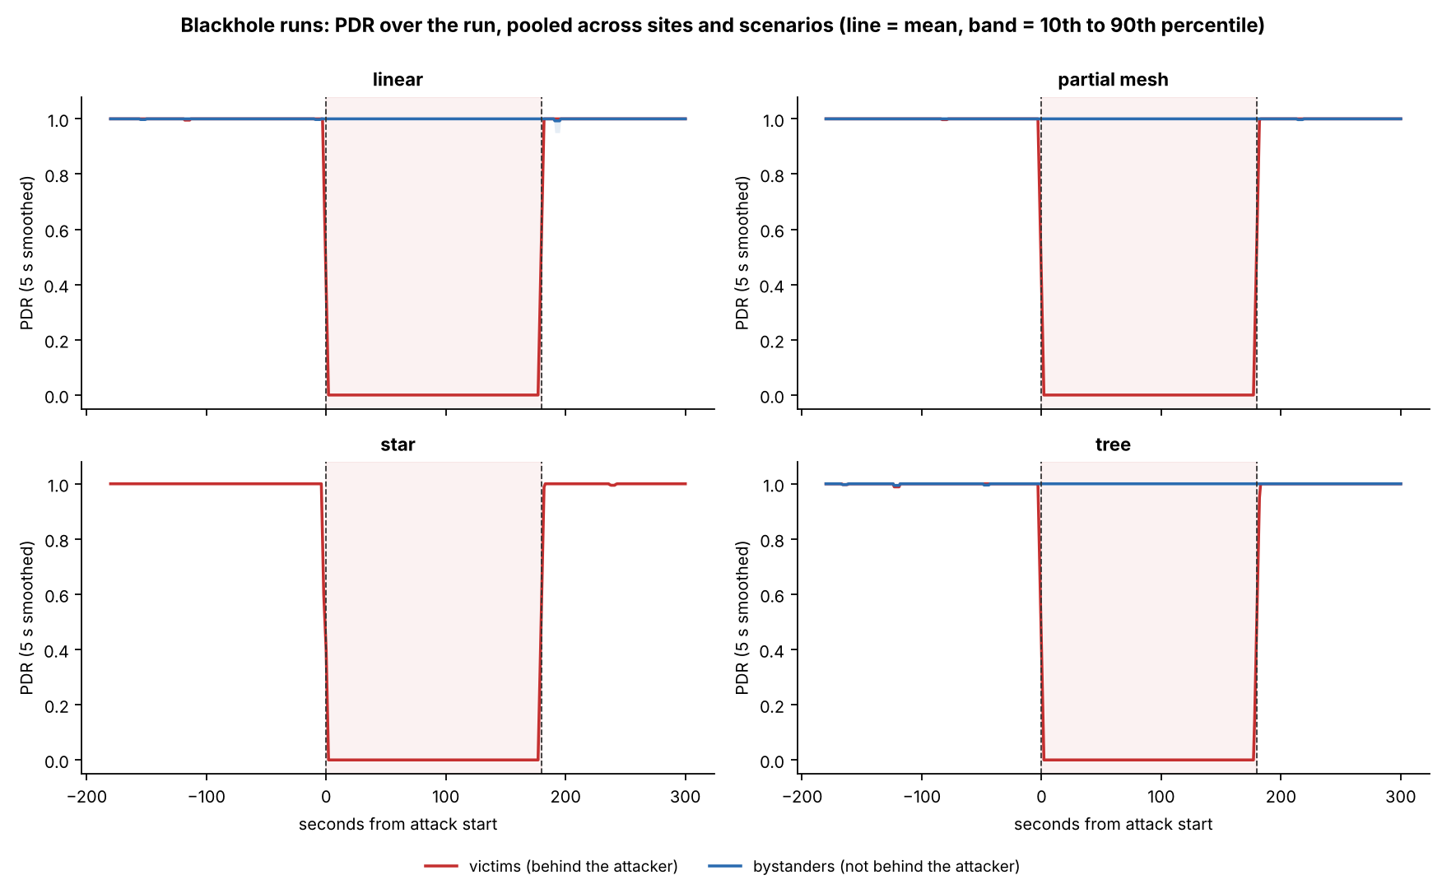
Blackhole: confirmed in all 36 runs
36 / 36
blackhole runs confirmed (4 strong, 27 good, 5 minor gaps)
Attacker ForwardingRatio: 1.000–1.004 → 0.000–0.007
Victim PDR: 0.998 → 0.000; every one of the 123 victims averaged exactly 0
121 of 123 victims cut off in the first second; recovery median 2 s
Bystanders: 0.996 → 1.000
How to read it
Axes: Figure 6.2: x = seconds from the attack start (0 to 180 shaded); y = PDR smoothed over 5 s; one panel per topology.
Colours: Red = victims (behind the attacker), blue = bystanders (not behind it).
Look for: Red drops like a cliff at 0 and returns right after 180; blue never moves; the star has only red (no bystanders).
Notes:
KEY FACTS
- Table 6.9: attacker ForwardingRatio primary passed 36 of 36; PDR primary 35 of 36 (one excluded: unstable baseline 0.930 ± 0.253, partial/Yuchengco/stationary)
- Support checks: ConsistencyScore 31/36, IngressEgressDelta 31/36, NeighbourForwardingRatio 32/36 (4 runs had no attack values; none failed)
- Where z was finite (21 runs) the attacker's ForwardingRatio sat at least 22.9 SDs away, median 111; in 15 runs the baseline never varied
- Example run, G402 linear stationary: attacker received 1,077 probes in the attack and forwarded 1 (ForwardingRatio ≈ 0.001)
- The other 2 victims fell below 0.5 within 1 s; recovery within 3 s for 122 boards (one went silent)
- Figure 6.1: every cell of the 36-run grid shows victim attack PDR 0.00
SOURCE: Section 6.2.1, Table 6.9, Figures 6.1 to 6.3

Slide 19
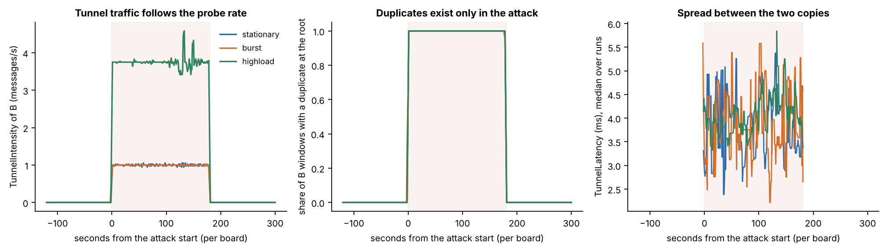
Wormhole: confirmed in all 36 runs
36 / 36
99.86%
0
3.9 ms
wormhole runs confirmed (21 strong, 15 good)
of end B's probes reached the root twice (12,448 of 12,465)
duplicates in baseline or cooldown, and none from other boards
median gap between the two copies of a probe
How to read it
Axes: Fig. 6.5: x = seconds from attack start; y = B's tunnel messages/s | windows with a duplicate | copy spread (ms).
Colours: Blue, orange, green = stationary, burst, highload runs; the shaded band is the 180 s attack.
Look for: All three stay at zero outside the attack; highload carries about 4 messages/s; the spread is a few ms.
Notes:
KEY FACTS
- Table 6.11: DuplicateRate of B 36/36 (baseline 0 in every run, attack 0.986 to 1.000); TunnelIntensity 36/36 (baseline ≤ 0.001 msg/s, attack 0.994 to 4.0)
- 6,468 of 6,469 attack windows of B held a duplicate (99.98%)
- B was deeper than A in every run; both ends kept the same hop for the whole run
- Hops skipped 1 to 5: linear 2 to 5 (median 4), partial mesh 1 to 2, star 1 (A is the hub), tree 1 to 2
- The wire: end A received 99% to 101% of what B sent, all 36 runs
- Spread: 90th percentile 12.1 ms, 99th 417 ms (84 windows above 200 ms); no link with hops skipped (Spearman 0.25, p = 0.14)
- Out-of-order arrivals rare: 232 of 24,913 (0.93%), mostly 3 highload runs
- Grades: 15 good = 9 partial mesh plain-tree notes + 6 runs with no saved root run log
IF ASKED
- "Why does the wormhole have no victims?" Only B's own probes are tunnelled; the attack is the duplication
SOURCE: Section 6.2.2, Table 6.11, Table 6.12, Figures 6.4 to 6.6

Slide 20
Benign runs: no attack signature
8 / 8
0 of 21
24 of 24
benign runs confirmed benign, all strong
evaluable signature checks passed
cooldown comparisons within 0.5 baseline SD
?
How a benign run is tested
!
What 8 runs can and cannot show
Same tests, pointed the other way: cooldown against baseline
No signature may pass; delivery must stay healthy (PDR ≥ 0.90, every relay forwards ≥ 90%)
Mean PDR per run: 0.9994 to 1.0000
Enough as a control: none triggered the verifier
Not enough for a false-alarm rate; the paper says so and recommends more benign runs
Within one topology, benign scenario and site are confounded
Notes:
KEY FACTS
- 43 other checks needed a tunnel or an attacker, so they had no data, as expected
- Only 4 of 54 child boards ever had a window below PDR 1, all in linear/G402/highload (lowest 0.75)
- Benign runs: no hop change in any run; 1 parent change across all 8 runs
- Probe rate matches the scenario in both kinds of run (about 1.0, 1.1 and 3.9 per board per second)
- Tree and partial mesh have one benign run each, both at G402
IF ASKED
- "Are 8 benign runs enough?" As a control yes; for a false-alarm rate no (Section 6.5.4, Recommendation 2)
SOURCE: Sections 6.2.6 and 6.3.3

Slide 21
Can one feature decide it? The single-feature audit
Majority rate ≈ 70%: 420 normal s of 600 s
PDR separates victims at 99.9%: a full delivery collapse is separable by construction
Only 86.9% on all nodes: bystanders carry the attack label but behave normally
LatencyHopRatio is missing when a probe is dropped, which gives the label away, so it is not clustered
Wormhole: on non-attacker nodes no feature beats 70% by more than 0.01 points
How to read it
Axes: Each bar = best accuracy of one threshold on that feature; axis starts at 50%. † = judged only where it has a value.
Colours: Blue = all non-attacker nodes, red = victims only.
Look for: A bar at 70% knows nothing (always answering "normal" also scores 70%); only PDR and LatencyHopRatio rise.
Notes:
KEY FACTS
- Why the audit: if one feature alone separates attack from normal, clustering adds nothing, or the feature is an artefact (Arp et al. [80], spurious correlation)
- Method: best single threshold per feature (looking at the labels), compared with always answering "normal"
- LatencyHopRatio's missingness alone predicts a victim's label with 99.2% accuracy
- Run clock 80%: every run follows the same schedule; kept out of the model inputs
- Every RSSI and topology feature stays at the majority rate
- Wormhole ends: tunnel features 99.7% (they carry messages only in the attack); RetryRate 100% on B only because B's counter holds the tunnelled frames
- Leakage guard: RetryRate, the tunnel features and the relay features may never be model inputs; LatencyHopRatio also excluded
IF ASKED
- "If PDR alone detects the blackhole, why cluster at all?" That is what this audit tests and we report it; any future model must beat a plain PDR threshold (Recommendation 5)
SOURCE: Section 6.2.3, Tables 6.13 and 6.14

Slide 22
Predictions tested: traffic yes, radio and routing no
Prediction (Tables 3.4, 3.5) | Observed? | Measured
Blackhole: victims retransmit more | No | App counter 0.0000 → 0.0004; sniffer (7 runs): 3 up, 4 down
Wormhole: hop counts change | No | 0 windows with a hop change in any phase
Wormhole: impossible parent links | No | 0 windows with a parent change
Wormhole: RSSI does not fit the depth | No | RSSI_Hop_Diff A 2.79 → 2.76 dB; B 5.41 → 5.68 dB
Wormhole: RSSI variance rises | No | Cohen's d −0.03 (A), −0.07 (B)
Wormhole: duplicate arrivals at the root | Yes | 6,468 of 6,469 attack windows of end B
Wormhole: latency mismatch between copies | Yes | Median spread 3.9 ms
What belongs to the traffic the tunnel creates was observed; what belongs to routing and radio was not.
Notes:
KEY FACTS
- Retransmissions: the attacker still ACKs every frame at the link layer, so a victim's radio sees no failure
- App-counter failed sends in only 9 of 21,742 victim attack windows
- Sniffer (real 802.11 Retry bit), 7 runs: victims 0.295 -> 0.364 -> 0.323, but the sign differs between runs; 7 runs are too few to rule out a small effect
- Victim ParentSwitchRate 0.00000 -> 0.00009 (d = 0.01)
- Routing table entries: not measured (firmware does not log the routing table)
- Retransmissions near the wormhole ends: not measurable (B's counter holds tunnel frames; others 0)
- Out-of-order arrivals: rare (0.93%)
- Exactly what an application-layer tunnel implies (D-20)
IF ASKED
- "Where is the MAC layer in your cross-layer dataset?" No MAC retry count in ESP-IDF (D-15); sniffer Retry bit in 7 runs showed no consistent rise; the MAC side rests on RSSI and link/parent state
SOURCE: Section 6.2.4, Tables 6.15 and 6.16

Slide 23
How to read box plots and Cohen's d
A box plot (Figures 6.9, 6.12, 6.15)
Cohen's d: how big is the shift?
upper whisker (≤ 1.5 × IQR)
d = (attack mean − baseline mean) ÷ pooled SD
most features: |d| < 0.1
blackhole victim PDR: |d| = 29.71, far off this scale
75th percentile (top of the box)
median (the line)
negligible
small
medium
large
0
0.2
0.5
0.8
1.0
25th percentile (bottom of the box)
Negative = lower during the attack
A size, not a significance test: the windows of one board follow each other, so they are not independent
Wormhole ends: TunnelIntensity d = 1.83; wormhole non-attacker nodes: largest |d| = 0.06
lower whisker
Box = IQR, the middle half of the values. Blue = baseline, red = attack. Boxes that overlap mean the feature did not change.
Worked check: d = −29.71 with means 0.998 → 0.000 implies a pooled SD of about 0.034 (0.998 ÷ 29.71). The mean moved almost 30 typical spreads.
Notes:
KEY FACTS
- IQR = interquartile range: from the 25th to the 75th percentile; whiskers reach the furthest value within 1.5 IQR; the figures' titles say "boxes: IQR, whiskers 1.5 IQR"
- Panels marked "one value in every box" are features that never varied (for example ParentSwitchRate, HopChangeCount)
- Cohen's d: |d| below 0.2 negligible, about 0.5 medium, 0.8 or more large
- Victim PDR: baseline 0.9977, attack 0.0000, d = -29.71; every other feature of victims and bystanders |d| < 0.1 (largest: bystanders' RSSI_var, -0.09)
- d describes size only: windows of one board are not independent, so no p-values are claimed from d
IF ASKED
- "Why no significance test?" Windows follow each other in time; the real sample size is closer to 80 runs than 456,195 windows (Section 6.5.4)
SOURCE: Sections 6.3.1 and 6.3.2, Tables 6.18 and 6.19

Slide 24
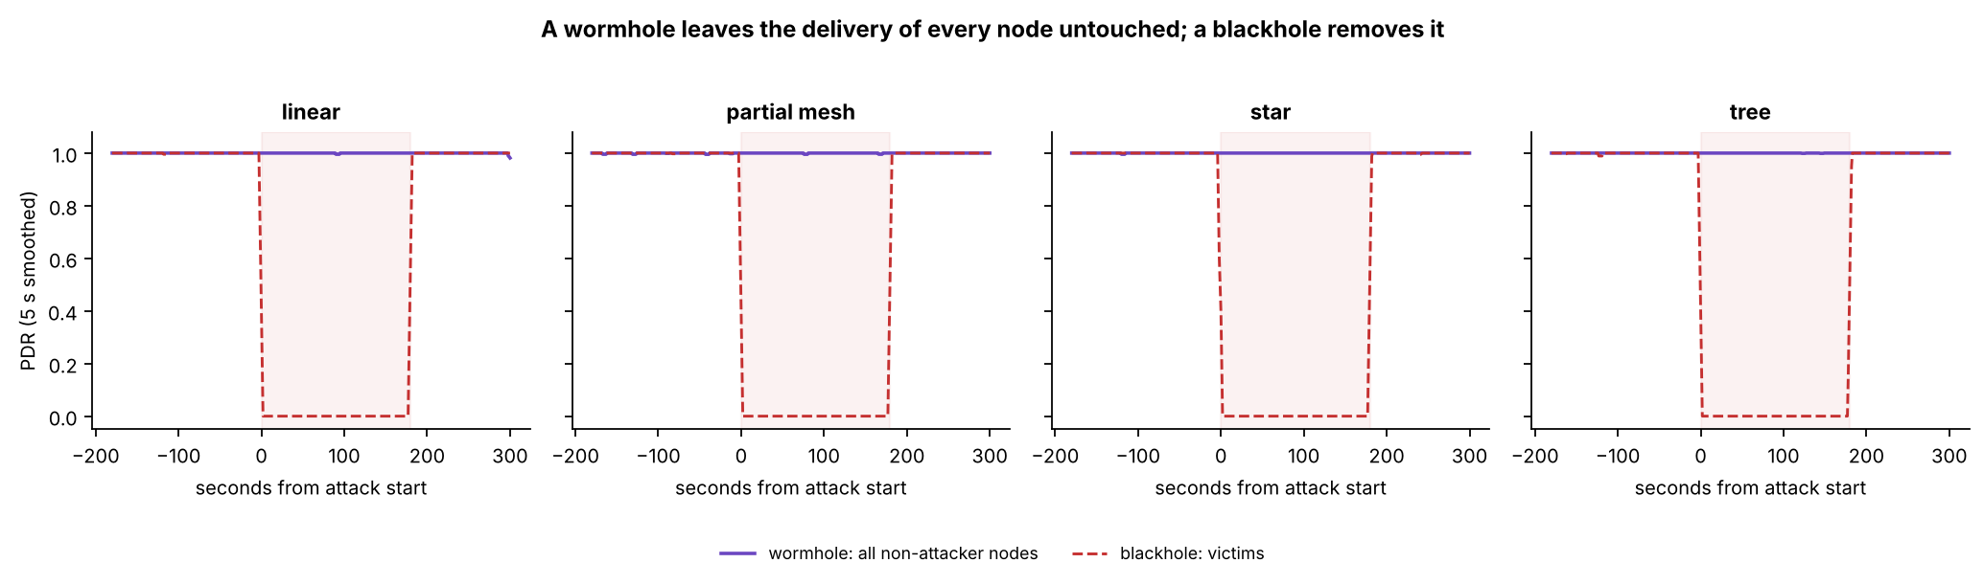
EDA: only the delivery of the victims moves
Blackhole: victim PDR 0.998 → 0.000, Cohen's d = −29.71. Every other feature of victims and bystanders: |d| < 0.1.
Wormhole: non-attacker PDR 0.9999 → 0.9999; largest |d| = 0.06. On the ends only the tunnel features change (0 → 1.92 msg/s).
How to read it
Axes: Figure 6.11: x = seconds from the attack start; y = PDR smoothed over 5 s; one panel per topology.
Colours: Solid purple = wormhole non-attacker boards; dashed red = blackhole victims; shaded = the attack.
Look for: Purple never leaves 1; red sits at 0 for the whole attack: the one-picture contrast between the two attacks.
Notes:
KEY FACTS
- Cohen's d = (attack mean - baseline mean) / pooled SD; |d| < 0.2 negligible, 0.8+ large; descriptive only, windows are not independent
- d = -29.71 implies a pooled SD of about 0.034: the mean moved almost 30 times the typical spread
- Victims' RSSI is about 2.5 dB weaker than bystanders' already in the baseline (-74.7 vs -72.2 dBm): they sit deeper
- Bystanders' LatencyHopRatio falls 4.26 -> 3.15 -> 2.46 ms/hop and keeps falling after the attack; benign runs show the same, so it follows the course of a run
- Correlations: the strong pairs are formula-linked (ForwardingRatio vs ConsistencyScore, Spearman -0.94); no other FULL-set pair exceeds |0.4|
- Wormhole ends: TunnelIntensity d = 1.83; TunnelBytes 0 -> 57.5 bytes; B's RetryRate 0.00 -> 0.50 is the tunnel counter, not retries
- RSSI_Hop_Diff is higher on B (5.4 dB vs 2.7 to 2.8) but equally high before the attack: it reflects where B sits
SOURCE: Sections 6.3.1 and 6.3.2, Tables 6.18 and 6.19, Figures 6.9 to 6.12

Slide 25
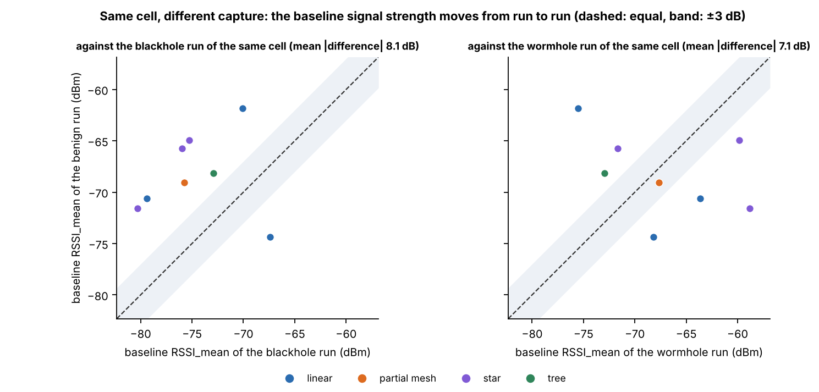
Signal strength separates captures, not attacks
≈ 8 dB
mean difference in baseline RSSI_mean between two captures of the same cell, in both directions
Each capture is a fresh set-up; signal strength depends on exactly where each board stands
RSSI_mean is the only big difference between benign and attack-run normal windows (d = 0.69)
Benign cooldown stays within 0.5 baseline SDs in 24 of 24 comparisons
For clustering: RSSI_mean can split windows by set-up instead of by attack
How to read it
Axes: Figure 6.16: x = baseline RSSI_mean of the attack run of the same cell (dBm); y = baseline RSSI_mean of the benign run.
Colours: Blue = linear, orange = partial mesh, purple = star, green = tree; one point per benign run.
Look for: Dashed line = equal, band = ±3 dB; the points land on both sides and mostly outside the band.
Notes:
KEY FACTS
- Mean |difference| 8.1 dB against the blackhole run of the same cell, 7.1 dB against the wormhole run (figure panel titles)
- Points fall on both sides of the equal line and mostly outside the ±3 dB band
- Consequence: one run per cell cannot separate site effects from capture-to-capture variation
IF ASKED
- "Why is RSSI so different between runs of the same cell?" Each capture is a new set-up; RSSI depends on exact board placement
SOURCE: Section 6.3.3, Tables 6.22 and 6.23, Figure 6.16

Slide 26
Clustering: how the data were asked to sort themselves
5
Algorithms
3
Feature sets
4
Scores
K-Means
Ward (hierarchical)
GMM (Gaussian mixture)
DBSCAN (eps at the k-distance knee)
Spectral
FULL: 8 features allowed by the leakage guard
REDUCED: PDR, RSSI_mean, RSSI_var, RSSI_Hop_Diff
Without PDR: the 3 RSSI features, as a control
Silhouette, Davies–Bouldin: cluster shape, no labels
Purity, ARI: agreement with the label, computed only afterwards
ARI: 1 = exact, 0 = chance
6,000 sampled windows per seed (42, 7, 123), standardised features, k = 2 to 8. The algorithm never sees the label.
Notes:
KEY FACTS
- Clustering groups windows only by how similar their features are; the label is used afterwards to score the groups
- Why 16 features become 8: relay features, RetryRate and tunnel features are blocked by the leakage guard; LatencyHopRatio's missingness predicts the label in 86% of windows
- REDUCED = FULL after the low-variance filter (drop if > 90% of windows share one value) and the correlation filter (|r| > 0.85, removed nothing; largest |r| 0.11)
- Removed by low variance: ParentSwitchRate (100% one value), HopChangeCount (100%), HopStabilityDuration (99.8%), RSSI_stability (98.5%)
- Two populations: all non-attacker nodes (127,372 windows) and victims only (72,687)
- DBSCAN min_samples between D+1 and 2D; eps at the knee (0.79, 0.73, 0.56); best-silhouette setting kept
- Purity trap: purity 0.702 = the majority rate = no separation; always read purity against it
SOURCE: Sections 4.2.5 and 6.4.1, Table 6.24

Slide 27
How to read the clustering scores
Score | Question it answers | Uses the label? | How to read it
Silhouette | How close is a window to its own cluster compared with the nearest other one? | No | −1 to 1, higher = tighter. Describes shape, not the attack
Davies–Bouldin | How compact and how far apart are the clusters? | No | 0 and up, lower = better. Same caveat as the silhouette
Purity | What share of windows carries the majority label of their cluster? | Yes, afterwards | Compare with the majority rate: 0.70 = no separation
ARI | Do the clusters agree with the label, corrected for chance? | Yes, afterwards | 1 = exact, 0 = chance. Here the best possible is 0.515
The ARI scale, with the blackhole results on it
chance
0.5
exact
0 without PDR (−0.016 to 0.002): nothing separates
0.514 K-Means, all nodes; 0.515 is the best possible
0.996 K-Means, victims only
Notes:
KEY FACTS
- Silhouette and Davies-Bouldin never see the label; purity and ARI use it only afterwards, to grade the clusters
- A high silhouette does not mean the clusters match the attack: on FULL, K-Means and Ward score their best silhouette at k = 2 (0.77, 0.90) while K-Means ARI there is only 0.172
- Purity trap: purity 0.702 is just the majority rate of the sample, i.e. no separation
- ARI counts pairs of windows that are together in both the clustering and the labels, minus what chance would give; negative = worse than chance
- Best possible ARI on all non-attacker nodes = 0.515 (43.2% of attack-labelled windows are bystanders); on victims only the same method scores 0.996
- Setup: standardised features, k from 2 to 8, three seeds (42, 7, 123), 6,000 sampled windows per seed; results are means over seeds, k = 2 unless stated
IF ASKED
- "Why report purity at all?" Because it is the common score; we always read it against the majority rate, and ARI is the one corrected for chance
SOURCE: Sections 4.2.5 and 6.4.1; Equations 4.21 to 4.24

Slide 28
Blackhole clustering: PDR carries all the separation
0.514
K-Means ARI on all non-attacker nodes; best possible is 0.515
≈ 0
every algorithm, every k, without PDR (−0.016 to 0.002)
Remove one feature and the separation disappears: the blackhole leaves no mark on signal strength or topology.
How to read it
Axes: x = clustering algorithm; y = adjusted Rand index (ARI): 0 = chance, 1 = exact agreement with the label.
Colours: Blue = all non-attacker nodes, red = victims only; REDUCED feature set, k = 2, mean of 3 seeds.
Look for: K-Means on victims only reaches about 1; on all nodes every method stops near 0.5, the ceiling on these labels.
Notes:
KEY FACTS
- DBSCAN finds 5 to 9 clusters; it agrees with K-Means
- Spectral finds the attack on one seed and not the others; reported, not relied on
- FULL set: K-Means mean ARI 0.172 (per seed 0.515, 0.000, 0.000); DBSCAN 0.476 / 0.929
- Silhouette trap: on FULL, K-Means and Ward score their best silhouette at k = 2 (0.77, 0.90) but the split is not the attack (seed 7: 44 windows of extreme RSSI variance; seed 123: one window with a parent change). Attack recovered at k = 4 (0.505)
- Lesson: choose k with elbow, silhouette and interpretability together, as planned in Chapter 4
- Robustness: inside every site and topology K-Means stays within 0.03 of that subgroup's ceiling (star 0.999, no bystanders)
- Run-level check: one model on all windows gives ARI 0.511, 95% interval 0.41 to 0.63 when the 36 runs are resampled
- K-Means cluster B (seed 42): 1,010 windows, 99.4% attack-phase, mean PDR 0.000; RSSI barely differs from cluster A
IF ASKED
- "Why did silhouette say k = 2 is best when that split isn't the attack?" Silhouette measures shape, not agreement with the label
SOURCE: Sections 6.4.2 to 6.4.4, Tables 6.25 and 6.26, Figure 6.18

Slide 29
Why 0.514 is the best possible score
Attack-labelled windows of non-attacker nodes (38,232)
Victims: 21,733 (56.8%) delivery lost
Bystanders: 16,499 (43.2%) traffic untouched
1
The phase label marks every board of a blackhole run as "attack", bystanders included
0.514
K-Means, all non-attacker nodes
2
A bystander's PDR stays at 1.000, so no feature can show an attack that never reached it
0.515
best possible on these labels
3
Best possible split: victim attack windows vs. everything else. Its ARI is 0.515, purity 0.870
0.996
K-Means, victims only
Notes:
KEY FACTS
- Contingency of the best split: cluster 1 = 21,733 victim attack windows; cluster 2 = 16,499 bystander attack + 89,140 normal; N = 127,372
- ARI of that split = 0.515 (worked example in the study guide reproduces it exactly); purity (21,733 + 89,140) / 127,372 = 0.870 = K-Means' purity
- So K-Means found essentially exactly the windows in which the attack is felt
- This is a property of how labels are defined (by phase, per run), not a flaw in the data; the paper reports both populations for that reason
IF ASKED
- "ARI 0.514 is mediocre." The ceiling is 0.515 because 43.2% of attack-labelled windows are bystanders; victims alone score 0.996
SOURCE: Sections 6.4.2 and 6.4.3, Table 6.25

Slide 30
PCA and t-SNE: how to read the pictures
PCA
t-SNE
PC2
PC1
far apart: the distance means nothing
Rotates the data so axis 1 holds the most variance, axis 2 the next
Axes are in standardised feature units; the percentage on an axis is the variance it holds
A few extreme windows can stretch it into a thin column (Figure 6.22)
Places windows with similar features near each other
Axes have no units; only nearness means anything
Never read the distance between far islands
A group in a picture is not a cluster; a cluster is what an algorithm returns. We use these pictures to describe the data, and the scores decide whether a separation exists.
Notes:
KEY FACTS
- PCA (principal component analysis): PC1 holds the most variance, PC2 the next; Figure 6.22 PC1 30%, PC2 18%; Figure 6.23 PC1 38%, PC2 32%
- In Figure 6.22 PCA is squashed into a column because a few extreme RSSI-variance windows dominate the first component
- t-SNE: perplexity 40 in all figures; only nearness is meaningful; no units on the axes
- Both are drawn on a sample of 6,000 windows of non-attacker nodes
- Pictures describe; the clustering scores (ARI, purity, silhouette) and the single-feature audit are the evidence
IF ASKED
- "The red island looks like a detector." It is a picture of delivery loss (PDR); with PDR removed the same windows overlap (next slide), and the paper states that PDR is also the verifier's own check
SOURCE: Section 4.4 and Section 6.4.3, Figures 6.22 and 6.23

Slide 31
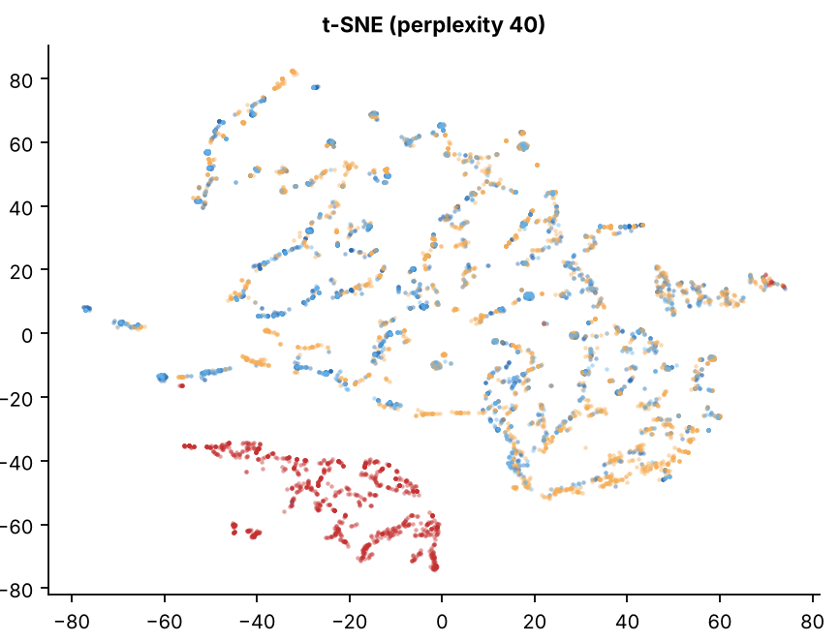
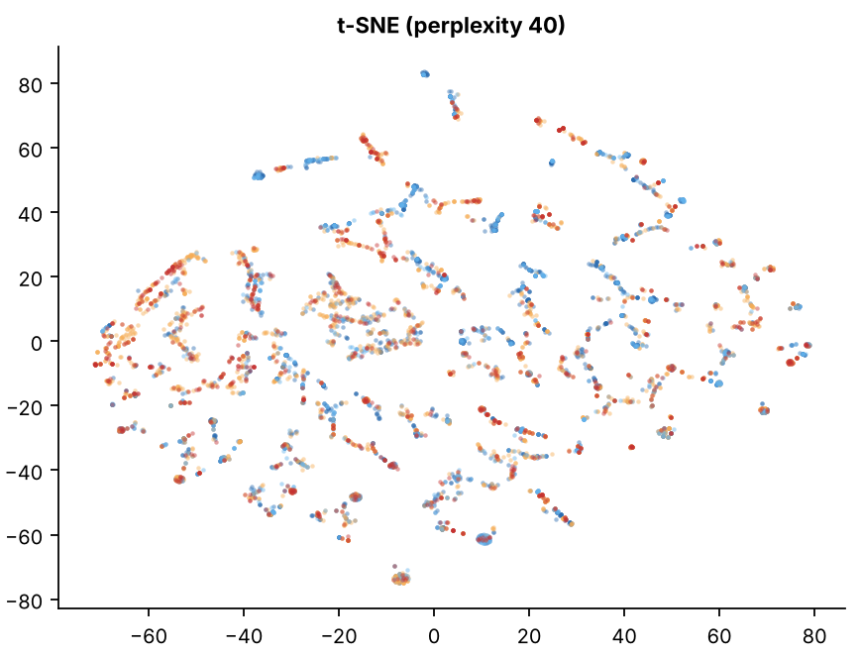
The same windows, with and without PDR
With PDR (FULL set, 8 features)
PDR removed (3 RSSI features)
Victim, attack
Bystander, attack
Victim, normal
Bystander, normal
How to read it
Axes: Figures 6.22 and 6.23 (t-SNE halves): no units, only nearness counts; 6,000 windows of non-attacker nodes.
Colours: Red = victim attack windows, light blue = bystander attack, orange = victim normal, dark blue = bystander normal.
Look for: With PDR the red windows form their own island; without PDR all four colours overlap.
Notes:
KEY FACTS
- Left: the red victim attack windows form their own island; light-blue bystander attack windows sit among the normal ones
- Right: same windows with only RSSI_mean, RSSI_var, RSSI_Hop_Diff; all four groups overlap: no structure to find
- PCA panels (in the paper): FULL set PC1 30%, PC2 18%; squashed by a few extreme RSSI-variance windows
- A group in a picture is not a cluster; a cluster is the output of an algorithm
SOURCE: Figures 6.22 and 6.23

Slide 32
Wormhole and pooled clustering
Wormhole: cross-layer features find nothing
Pooled: 80 runs, three labels
Non-attacker boards: ARI −0.012 to 0.003, every algorithm and k
Tunnel ends with the RSSI features: −0.012 to 0.009
Diagnostic only, TunnelIntensity added: DBSCAN reaches 0.827 on end B
The tunnel signal exists, but in the attackers' own counters, not in the cross-layer features
0.333 K-Means ARI; best possible 0.334
As a detector (one model applied to all windows):
Group | In the "victim" cluster
Victim attack windows | 21,733 of 21,733
Benign windows | 0 of 22,481
Normal, blackhole runs | 183 of 89,140
Wormhole attack windows | 3 of 32,194
Notes:
KEY FACTS
- Wormhole diagnostic: K-Means k = 2 on B gives ARI 0.000 because it splits by signal level (-67.6 vs -47.1 dBm, varies between runs); k = 3 isolates the highload tunnel windows (ARI 0.141); DBSCAN 9 to 12 nearly pure clusters
- TunnelIntensity is excluded from model inputs by the leakage guard; it was added only to ask whether any tunnel signal exists
- Pooled set: non-attacker boards of all 80 runs, 257,258 windows; labels normal 0, blackhole 1, wormhole 2
- Ceiling 0.334 (80 runs) and 0.317 (72 attack runs) on the 6,000-window samples; K-Means 0.333 and 0.315 = it finds the blackhole victims and nothing else
- Without PDR: -0.023 to 0.005
- Adding or removing the benign runs changes K-Means' ARI by only 0.017
- Bystander attack windows in the victim cluster: 0
SOURCE: Sections 6.4.6 and 6.4.7, Tables 6.28 and 6.32, Figures 6.25 and 6.30

Slide 33
Discussion: the attacks live in the data plane
Run type | Direct record | Cross-layer features that changed | Clustering
Blackhole | Attacker FR → 0.000–0.007; victim PDR 0.998 → 0.000 | Victim PDR only (d = −29.7); all others |d| < 0.1 | 0.514 (ceiling 0.515); ≈ 0 without PDR
Wormhole | B's probes reach the root twice (99.86%) | None (|d| ≤ 0.07; hop and parent unchanged) | ≈ 0 without a tunnel feature
Benign | 0 of 21 signature checks passed | Cooldown within 0.5 SD in 24 of 24 | 0 of 22,481 in the victim cluster
Main reading: Chapter 4 expected cross-layer evidence. The evidence sits in delivery (blackhole) and duplication (wormhole); PHY, MAC and network features stay where they were.
Honest qualifier: PDR is also the verifier's check, so the clustering finds the effect the verifier measured. It is not independent evidence that cross-layer features detect the blackhole.
Notes:
KEY FACTS
- Three consequences of emulation (6.5.3): results describe this kind of attack, not a routing-protocol attack; a detector here is tested on delivery loss and duplication; whether cross-layer features add anything stays open
- Limits (6.5.4): one run per cell; windows are not independent, so the real sample size is closer to 80 runs than 456,195 windows; partial mesh = plain tree; tree fan-out differs; no routing-table logging; sniffer on 7 runs; 8 boards indoors
IF ASKED
- "So your cross-layer features failed?" They did not respond to these attacks because these attacks never touch radio or routing; whether they help against routing attacks is Recommendation 1
SOURCE: Sections 6.5.1 to 6.5.4, Table 6.33

Slide 34
Compared with published studies
Measure | This study | Published | Reading
Baseline PDR | 0.998 victims; 0.9994–1.0000 benign | > 0.97, Khan et al. [22], ESP32 | Agree in size; counting differs
PDR under blackhole | 0.000 | 25–40% delivery, Airehrour et al. [70], RPL | Same direction; larger here (attacker on the path by placement)
Parent changes under blackhole | 0.00000 → 0.00009 per s | 16 to 246 rank changes [70] | Differs: their attack acts on routing (D-20)
Wormhole hop count | Constant | 4 → 3 hops, Zhukabayeva et al. [71], ZigBee | Their tunnel is a route; ours an app relay
Wormhole delay | 3.9 ms spread; B's LatencyHopRatio unchanged | 80–100 → 120–200 ms (about +40%) [71] | Different measure
Duplicate arrivals | 99.86% of B's probes; 0 in baseline | Proposed as a signature, Ramírez Gómez et al. [72] | Same evidence, different layer
Platforms, scales and protocols differ, so the comparison is about direction and rough size, not equal values.
Notes:
KEY FACTS
- Khan's figure is above 97% at every node except one outdoor node, from a multi-day stability test; ours is per one-second window
- Bystanders' baseline PDR 0.996
- Zhukabayeva's tunnel was GSM/GPRS; ours is a short UART wire, so the delay change is not expected to match
SOURCE: Section 6.5.2, Table 6.34

Slide 35
Chapter 7: Conclusion
7
What the objectives came to, what we contribute, our limits and recommendations

Slide 36
The three objectives, answered
Build an ESP32 mesh testbed with normal and attack traffic
80 of 80 runs; attacks confirmed in 72 of 72, benign in 8 of 8. Qualifiers: emulated attacks; partial mesh = branched tree
1
Achieved
Collect PHY, MAC and network features into a labelled dataset
16 features, labels from the schedule, every change documented (D-1 to D-37). Qualifier: no MAC retry count (D-15)
2
Achieved
Evaluate separability with EDA and clustering
Blackhole: through PDR only (0.514 vs 0.515). Wormhole: not with cross-layer features (−0.012 to 0.009)
3
Differs by attack
The expected cross-layer evidence was not found, because both attacks left radio and routing unchanged. We report this as a finding, not a failure.
Notes:
KEY FACTS
- Objective 3 detail: blackhole without PDR -0.016 to 0.002; pooled 80 runs, 3 labels: 0.333 vs best 0.334
- Wormhole visible only through the ends' counters and duplicate arrivals at the root
- Dataset validity (7.3): 72 attack runs passed (67 complete, 5 minor gaps); 1,372 windows (0.30%) dropped; 637 files none empty; one board (B768, bystander) with no data
IF ASKED
- Weak spots in Chapter 7 text: §7.3 typo "he attack" (missing T); §7.6 stray backtick after "directly"
SOURCE: Sections 7.3 and 7.4

Slide 37
Findings and contributions
Four findings
Three contributions
1
Blackhole: clear delivery loss among victims; PDR is the strongest indicator
1
Testbed
An ESP32 mesh for normal operation and two attacks under varied conditions
2
Wormhole: duplicate arrivals at the root, consistently and only during the attack
2
Dataset
80 runs with topology, site, scenario, role and phase on every row
3
Retransmissions, parent changes, hop counts and signal-to-hop did not change
3
Verification
A process that separates real attack effects from missing data or broken runs
4
Clustering depends on the feature tied to the attack: remove it and separation collapses
Notes:
KEY FACTS
- Finding 3 = the Table 3.4 and 3.5 rows that did not hold; kept as written on purpose
- Firmware and tools are in the project repository [79]
- Most important limitation: application-layer attacks (D-20)
SOURCE: Section 7.5

Slide 38
Limits and what should come next
Limitations
Recommendations
Application-layer attacks only
Only 8 boards, three indoor sites
Only 8 benign runs: no reliable false-alarm rate
No direct MAC retry count; sniffer on some runs only
One run per condition
Strong results rest on features tied to how the attacks were built
1
Attack routing directly
modifiable routing or forged management frames
2
Collect more normal data
benign runs in every cell, with repeats
3
Improve network measurement
a sniffer on every run
4
Test more wormhole scenarios
tunnel other nodes' traffic, other layouts
5
Evaluate detectors fairly
hold out whole runs; beat a PDR or duplicate baseline
Notes:
KEY FACTS
- Rec 1: see whether parent, hop, retry and RSSI features react once an attack really manipulates routing
- Rec 2: estimate a false-alarm rate across every topology, site and scenario
- Rec 3: also compare Tables 3.4 and 3.5 with what the testbed can actually measure
- Rec 5: hold out whole runs as test data; compare against simple baselines (PDR for blackhole, duplicates for wormhole); test with the main attack feature removed
IF ASKED
- "Do your results generalise?" No claim beyond 8 ESP32 boards, three indoor sites, three scenarios and application-layer attacks (6.5.4)
SOURCE: Sections 7.5 and 7.6

Slide 39
A validated testbed, a documented dataset, a verification process
Both attacks produced clear, measurable changes: the blackhole in delivery, the wormhole in duplicate arrivals. A starting point for ESP32 mesh attack research.
Thank you. Questions?
Notes:
KEY FACTS
- Final conclusion (7.7): detection depended on delivery and duplication; the other cross-layer features did not separate the attacks in this setup
- Because the attacks were application-layer, the results are not proof for routing-level attacks
SOURCE: Section 7.7

Slide 40
Backup: the other figures
B
Every other figure from Chapters 4 and 6, each with how to read it, to jump to if the panel asks
Notes:
KEY FACTS
- Not part of the timed talk: these are reference slides
- Each slide has the figure and a "How to read it" guide: what the axes are, what the colours mean, and the one thing to look for
- Figure numbers are the paper's own numbering

Slide 41
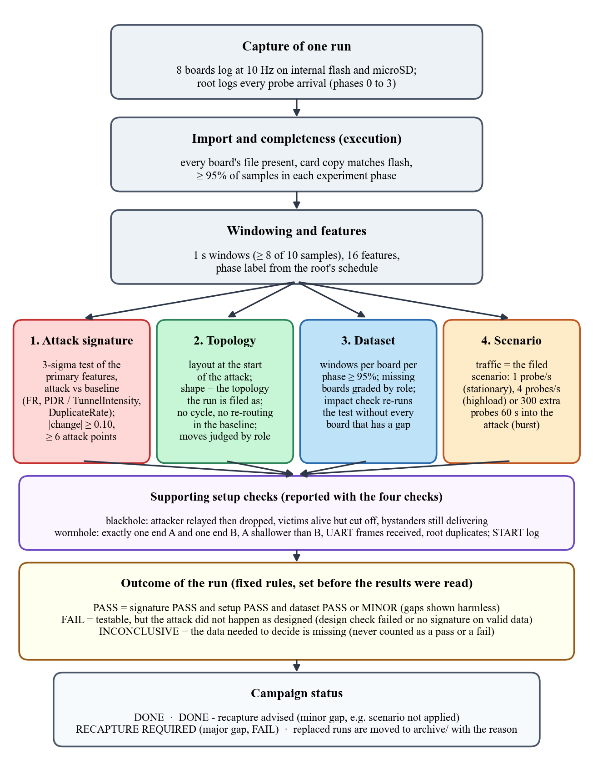
Figure 4.55: the order of the verifier's checks
How to read it
Axes
None. A flowchart read from top to bottom, one box per step.
Colours
Red, green, blue, orange = the four checks (signature, topology, dataset, scenario); purple = setup checks; yellow = outcome rules.
Look for
Every run takes the same path, and the outcome rules were fixed before any result was read.
Number
Outcomes: PASS, FAIL or INCONCLUSIVE.
Notes:
KEY FACTS
- The four checks run on the same windows
- Setup check confirms the roles: blackhole attacker relayed then dropped and victims are alive but cut off; wormhole has one A and one B, A shallower, and the wire delivered B's frames
- Missing data never becomes a pass or a fail
- Decision: keep, or archive and recapture
SOURCE: Section 4.2.7, Figure 4.55, Table 4.24

Slide 42
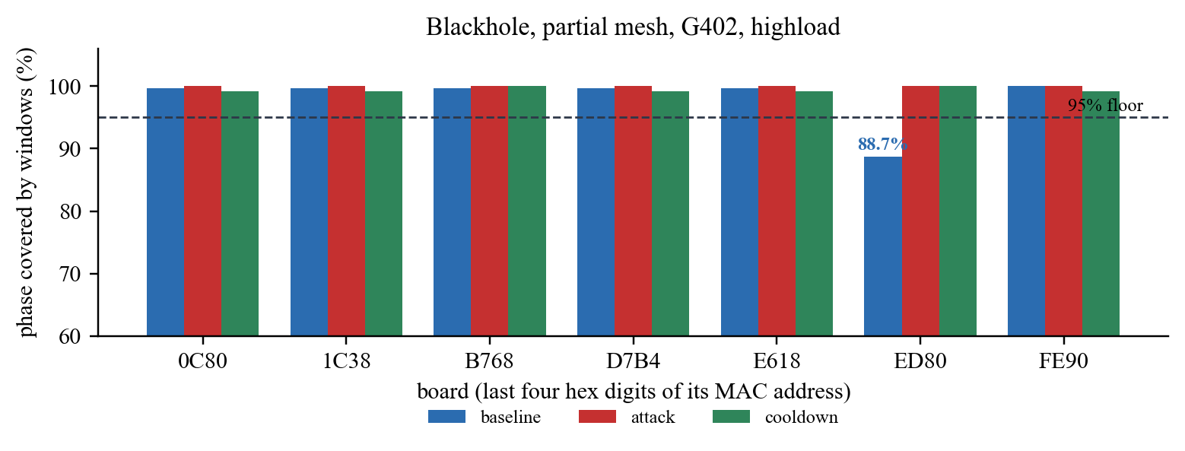
Figure 4.58: dataset check, one run
How to read it
Axes: x = board (last four hex digits of its MAC); y = share of each phase the board recorded, from 60 to 100%.
Colours: Blue = baseline, red = attack, green = cooldown; the dashed line is the 95% floor.
Look for: Every bar clears the floor except board ED80's baseline at 88.7%: a minor gap, the run is kept.
Notes:
KEY FACTS
- Run shown: blackhole, partial mesh, G402, highload
- Board ED80 covered 266 of 300 s of baseline (88.7%)
- The impact check reran the test without ED80; the attack was still confirmed, so the run is kept with a minor gap
- Missing boards are graded by role (D-32): attacker or tunnel end = major; victim or bystander = minor while others of that role remain
SOURCE: Section 4.2.7.3, Figure 4.58

Slide 43
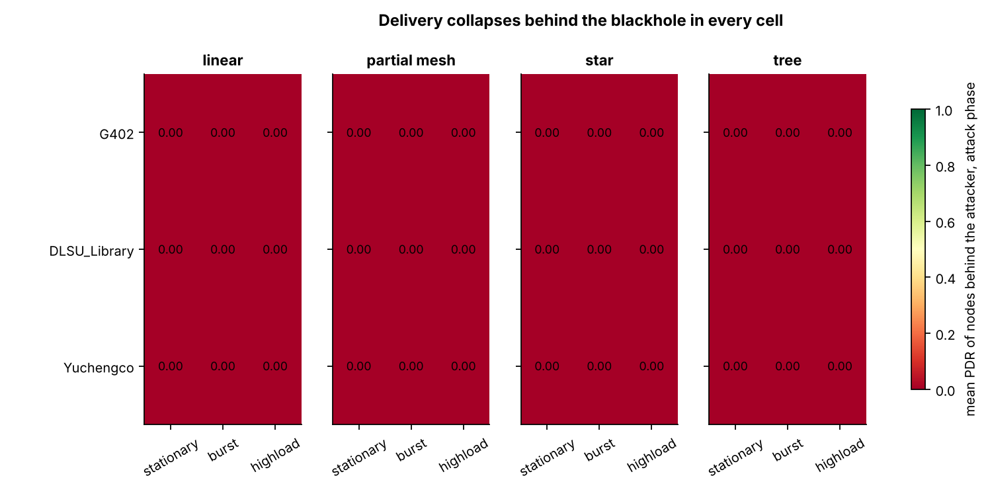
Figure 6.1: delivery collapses in every blackhole run
How to read it
Axes: One tile = one run: panels = topology, rows = site, columns = traffic scenario.
Colours: Dark red = mean PDR 0.00 of the boards behind the attacker during the attack; green would mean 1.0.
Look for: All 36 tiles are 0.00: in no run did a victim's probe reach the root during the attack.
Notes:
KEY FACTS
- Every one of the 123 victims has an attack-phase mean PDR of exactly 0
- 36 runs = 4 topologies x 3 sites x 3 scenarios
SOURCE: Section 6.2.1, Figure 6.1

Slide 44
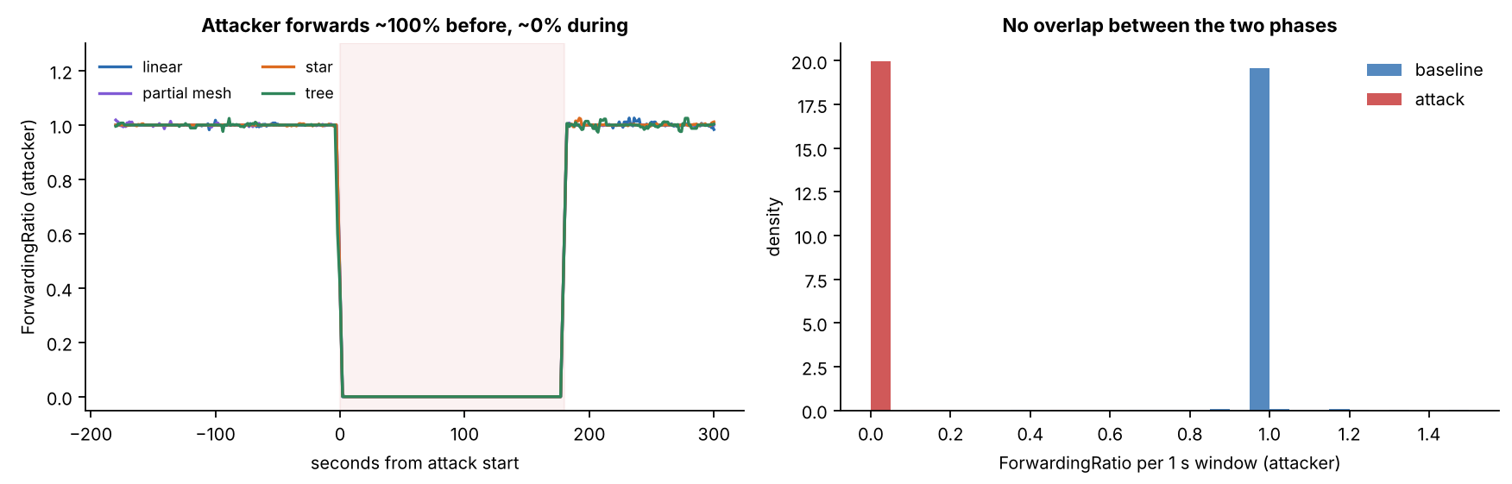
Figure 6.3: the attacker's ForwardingRatio
How to read it
Axes: Left: x = seconds from the attack start, y = ForwardingRatio. Right: histogram of its 1-second values.
Colours: Left: one line per topology, shaded = attack. Right: blue = baseline, red = attack.
Look for: The line falls from about 1 to about 0 for exactly the attack window; the two histograms never overlap.
Notes:
KEY FACTS
- Attacker ForwardingRatio 1.000 to 1.004 in the baseline, 0.000 to 0.007 in the attack, in all 36 runs
- Example run (G402 linear stationary): 1,077 probes received in the attack, 1 forwarded
SOURCE: Section 6.2.1, Table 6.9, Figure 6.3

Slide 45
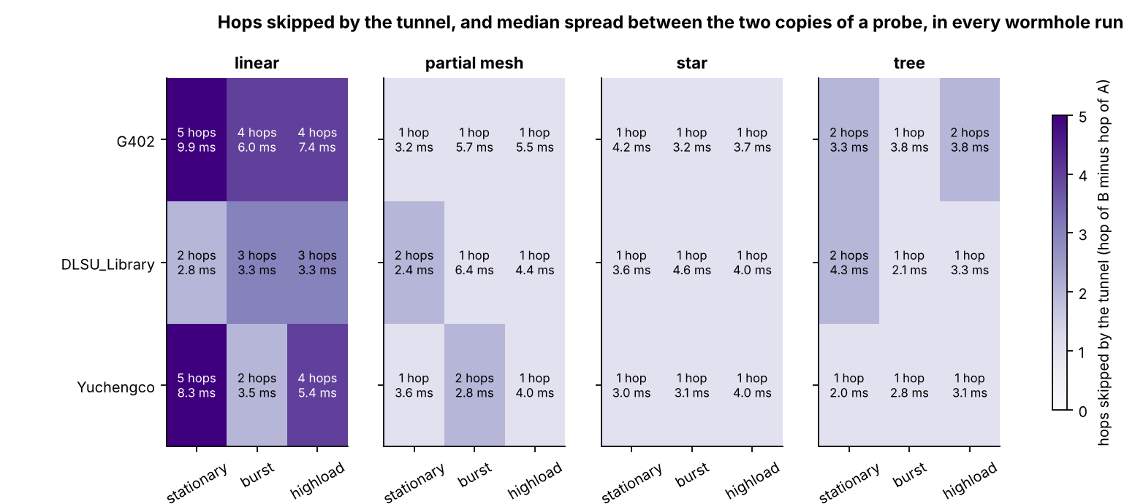
Figure 6.4: hops skipped by the tunnel, every wormhole run
How to read it
Axes: One tile = one wormhole run: panels = topology, rows = site, columns = traffic scenario.
Colours: Darker purple = more hops skipped (0 to 5); the second number is the median gap between the two copies in ms.
Look for: Only linear has deep shortcuts (2 to 5 hops); the star is always 1; the gap in ms does not grow with the hops.
Notes:
KEY FACTS
- Hops skipped: linear 2 to 5 (median 4), partial mesh 1 to 2, star 1 (A is the hub, D-28), tree 1 to 2
- In every run B was deeper than A and both ends kept their hop for the whole run
- Spearman 0.25, p = 0.14: no relation can be claimed from 36 runs
SOURCE: Section 6.2.2, Table 6.12, Figure 6.4

Slide 46
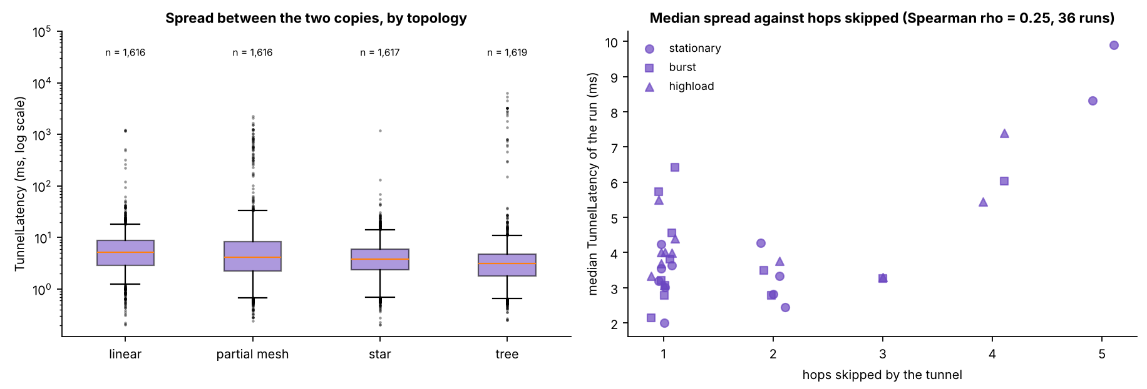
Figure 6.6: spread between the two copies of a probe
How to read it
Axes: Left: box plot per topology, y in ms on a log scale. Right: one point per run, x = hops skipped, y = median spread.
Colours: Boxes = IQR, whiskers = 1.5 IQR, dots = outliers; right: marker shape = scenario.
Look for: A few ms in every topology with a long tail; no upward trend with hops (Spearman 0.25, p = 0.14).
Notes:
KEY FACTS
- Median spread 3.9 ms, 90th percentile 12.1 ms, 99th percentile 417 ms (84 windows above 200 ms)
- Log scale: each gridline is ten times the one below
SOURCE: Section 6.2.2, Figure 6.6

Slide 47
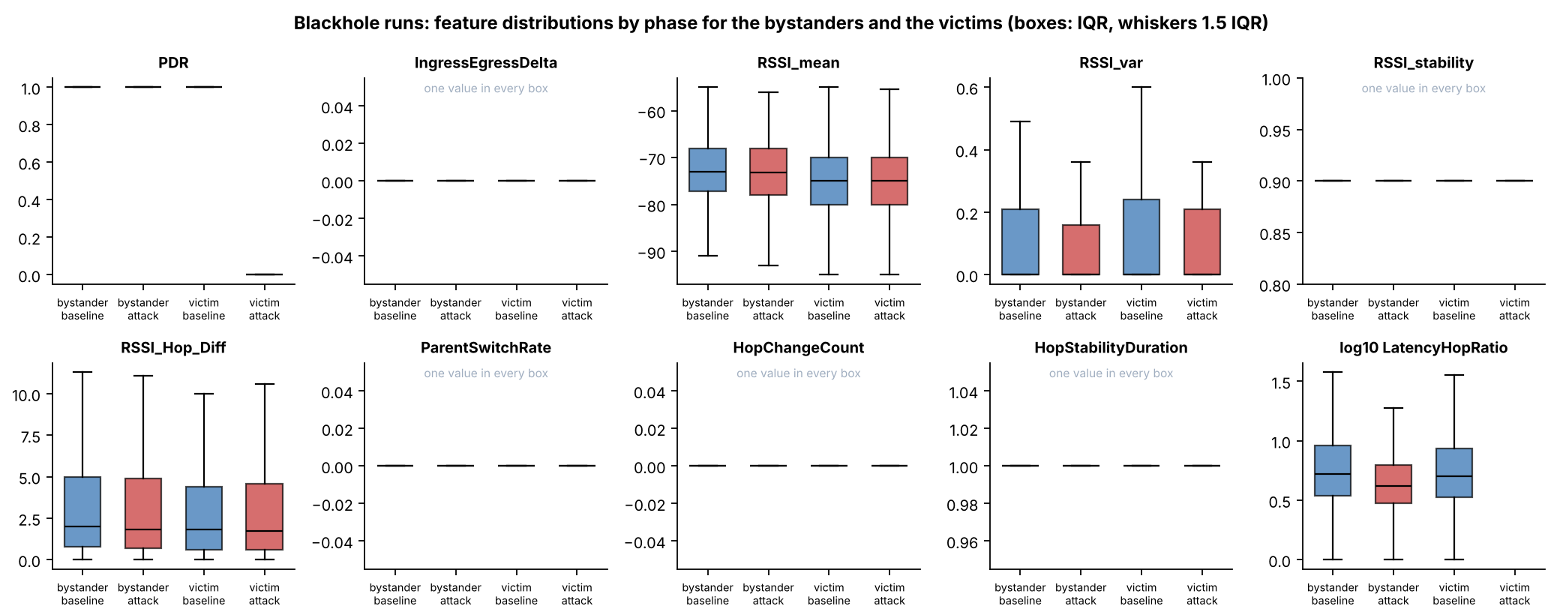
Figure 6.9: blackhole feature distributions by phase
How to read it
Axes: One panel per feature; four boxes each: bystander baseline, bystander attack, victim baseline, victim attack.
Colours: Blue = baseline, red = attack; box = IQR, whiskers = 1.5 IQR.
Look for: Only the PDR panel changes (the victim attack box sits at 0); the others overlap or hold one value.
Notes:
KEY FACTS
- Cohen's d: victim PDR -29.71; every other feature of victims and bystanders |d| < 0.1
- Panels marked "one value in every box" never varied
SOURCE: Section 6.3.1, Table 6.18, Figure 6.9

Slide 48
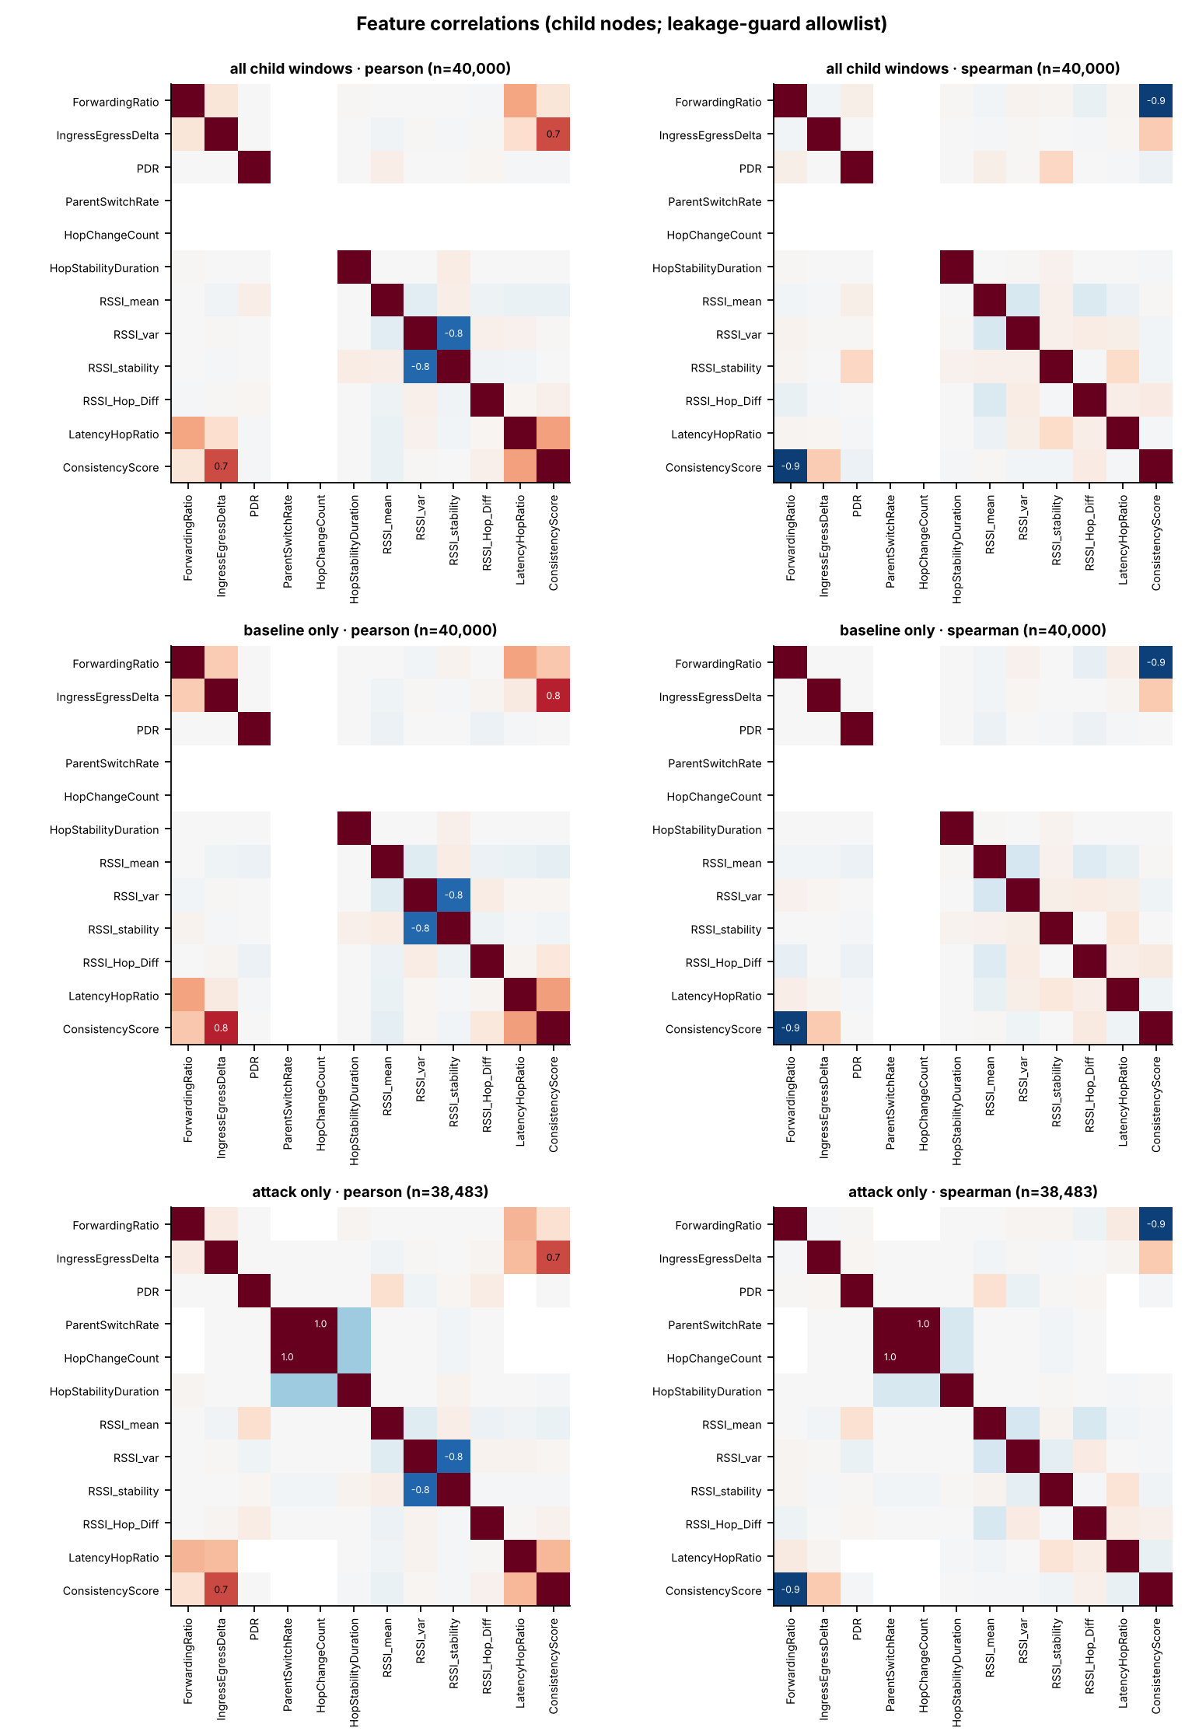
Figure 6.10: correlations between the features
How to read it
Axes
Both axes list the features. Left column = Pearson, right = Spearman; rows = all windows, baseline only, attack only.
Colours
Dark red = strong positive, blue = strong negative, white = none; the number is printed in strong tiles.
Look for
Only formula-linked pairs are strong (ForwardingRatio and ConsistencyScore, Spearman −0.94); blank rows are constant features.
Number
No other pair in the FULL set exceeds |0.4|.
Notes:
KEY FACTS
- Strong pairs are formula-linked, not behaviour-linked
- The correlation filter in the clustering removed nothing (largest |r| 0.11 among the allowed features)
SOURCE: Section 6.3.1, Figure 6.10

Slide 49
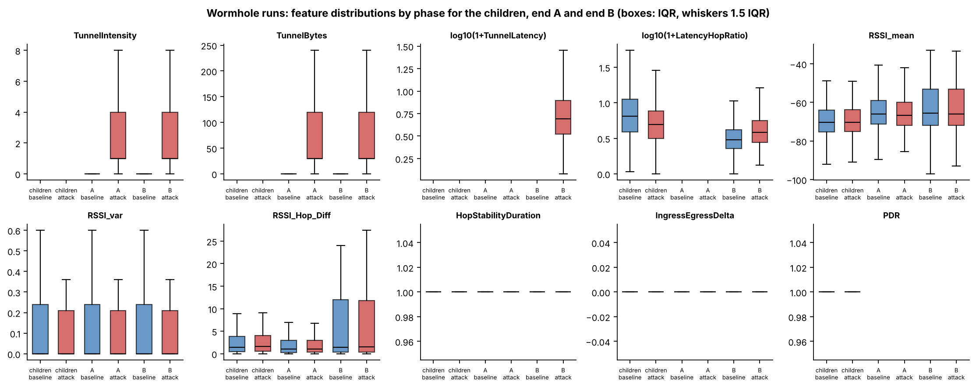
Figure 6.12: wormhole feature distributions by phase
How to read it
Axes: One panel per feature; boxes for children, end A and end B, each baseline then attack.
Colours: Blue = baseline, red = attack; box = IQR, whiskers = 1.5 IQR.
Look for: Only the tunnel panels change, and only on the ends; the RSSI boxes coincide between phases.
Notes:
KEY FACTS
- TunnelIntensity d = 1.83; TunnelBytes 0 to 57.5 bytes (30 bytes x 1.92)
- B's RetryRate rises 0.00 to 0.50, but that counter holds the tunnelled frames, not retries
- Non-attacker nodes: PDR 0.9999 to 0.9999, largest |d| = 0.06
SOURCE: Section 6.3.2, Table 6.19, Figure 6.12

Slide 50
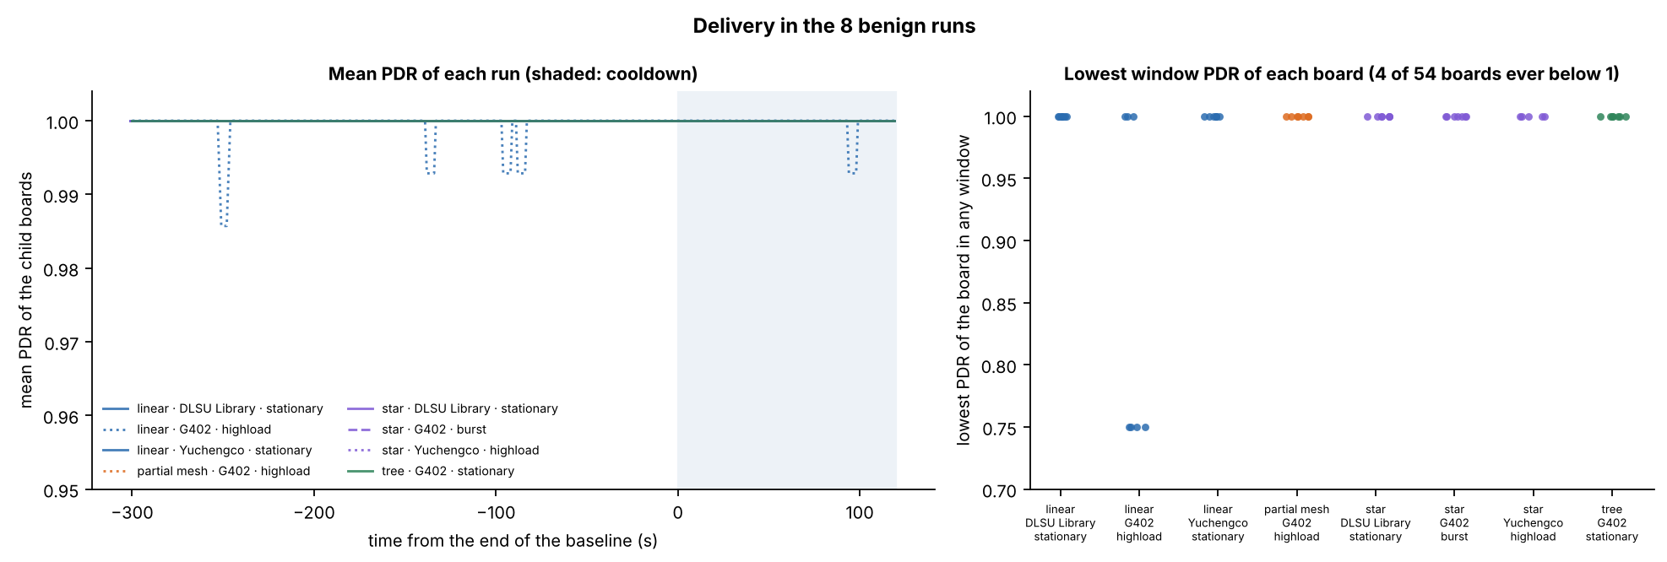
Figure 6.13: delivery in the 8 benign runs
How to read it
Axes: Left: x = time from the end of the baseline (s), y = mean PDR of the child boards. Right: lowest PDR any board reached.
Colours: One line (left) or one column of dots (right) per benign run; shaded = cooldown.
Look for: Flat at 1.00 with tiny dips; only 4 of 54 boards ever fell below 1, all in linear / G402 / highload (lowest 0.75).
Notes:
KEY FACTS
- Mean PDR per benign run 0.9994 to 1.0000
- Left axis starts at 0.95, so the dips look larger than they are
SOURCE: Sections 6.2.6 and 6.3.3, Figure 6.13

Slide 51
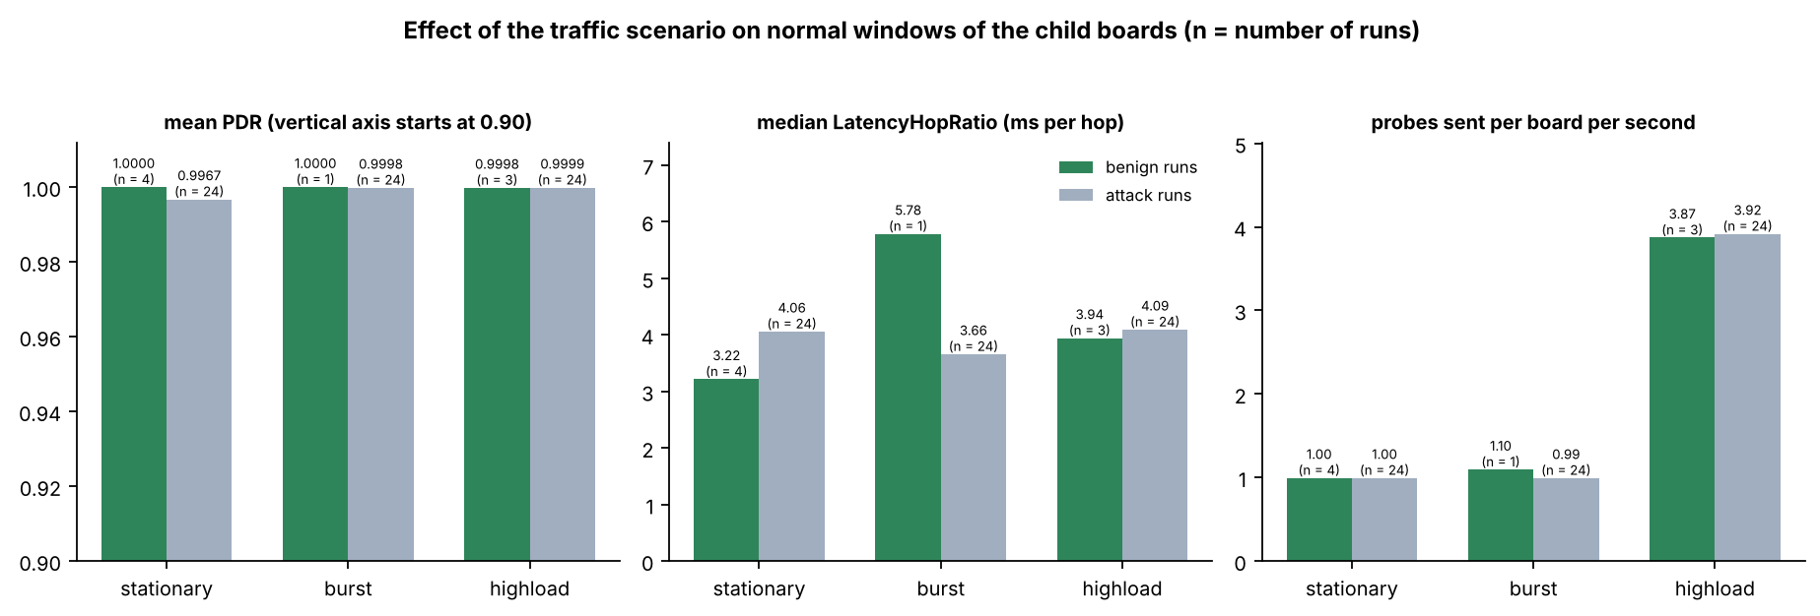
Figure 6.14: effect of the traffic scenario
How to read it
Axes: Three panels, x = scenario; y = mean PDR (axis starts at 0.90), median LatencyHopRatio, probes per board per second.
Colours: Green = benign runs, grey = attack runs (normal windows only); n = number of runs under each bar.
Look for: Matching bars: the scenario means the same in both kinds of run; highload is about 4 probes per second.
Notes:
KEY FACTS
- The PDR axis starts at 0.90, so a gap such as 1.0000 vs 0.9967 looks bigger than it is
- Probe rates about 1.0, 1.1 and 3.9 per board per second
SOURCE: Section 6.3.3, Figure 6.14

Slide 52
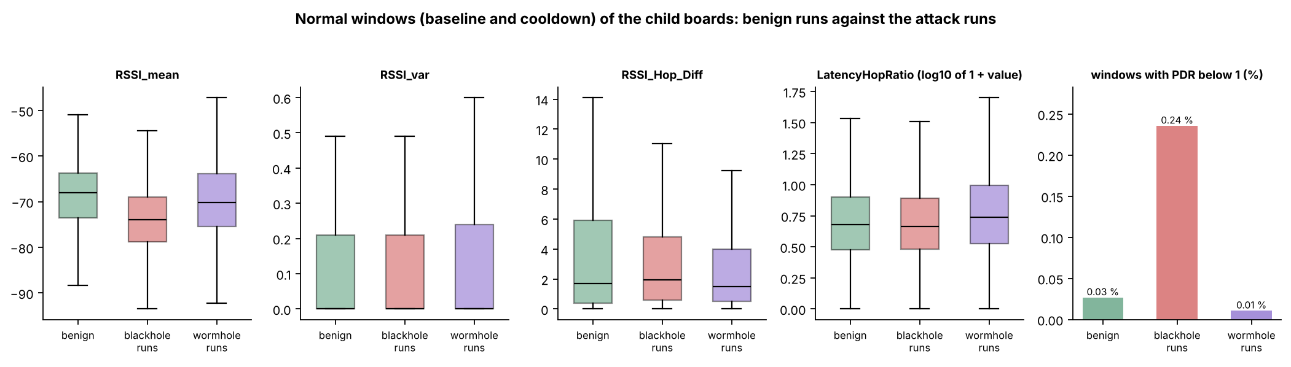
Figure 6.15: normal windows, benign vs. attack runs
How to read it
Axes: One panel per feature; y = the feature value; the right panel = share of windows with PDR below 1 (%).
Colours: Green = benign runs, red = blackhole runs, purple = wormhole runs; box = IQR, whiskers = 1.5 IQR.
Look for: Only RSSI_mean differs clearly between benign and attack runs: set-up, not attack (Figure 6.16).
Notes:
KEY FACTS
- Normal windows = baseline and cooldown of the child boards
- Windows with PDR below 1: 0.03% benign, 0.24% blackhole runs, 0.01% wormhole runs
SOURCE: Section 6.3.3, Tables 6.22 and 6.23, Figure 6.15

Slide 53
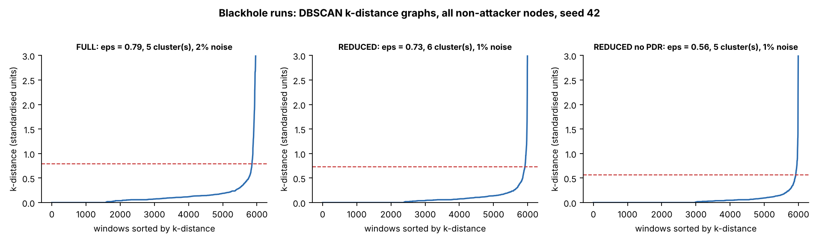
Figure 6.17: choosing eps for DBSCAN
How to read it
Axes: x = windows sorted by their distance to the k-th neighbour; y = that k-distance (standardised units).
Colours: Blue curve = k-distances; red dashed line = the eps that was chosen, at the knee.
Look for: The curve stays flat and then shoots up on the right: windows past the knee are the sparse ones, left as noise.
Notes:
KEY FACTS
- Panel titles give eps, number of clusters and share of noise windows (1 to 2%)
- min_samples between D+1 and 2D (D = number of features); the setting with the best silhouette is kept
SOURCE: Section 6.4.1, Figure 6.17

Slide 54
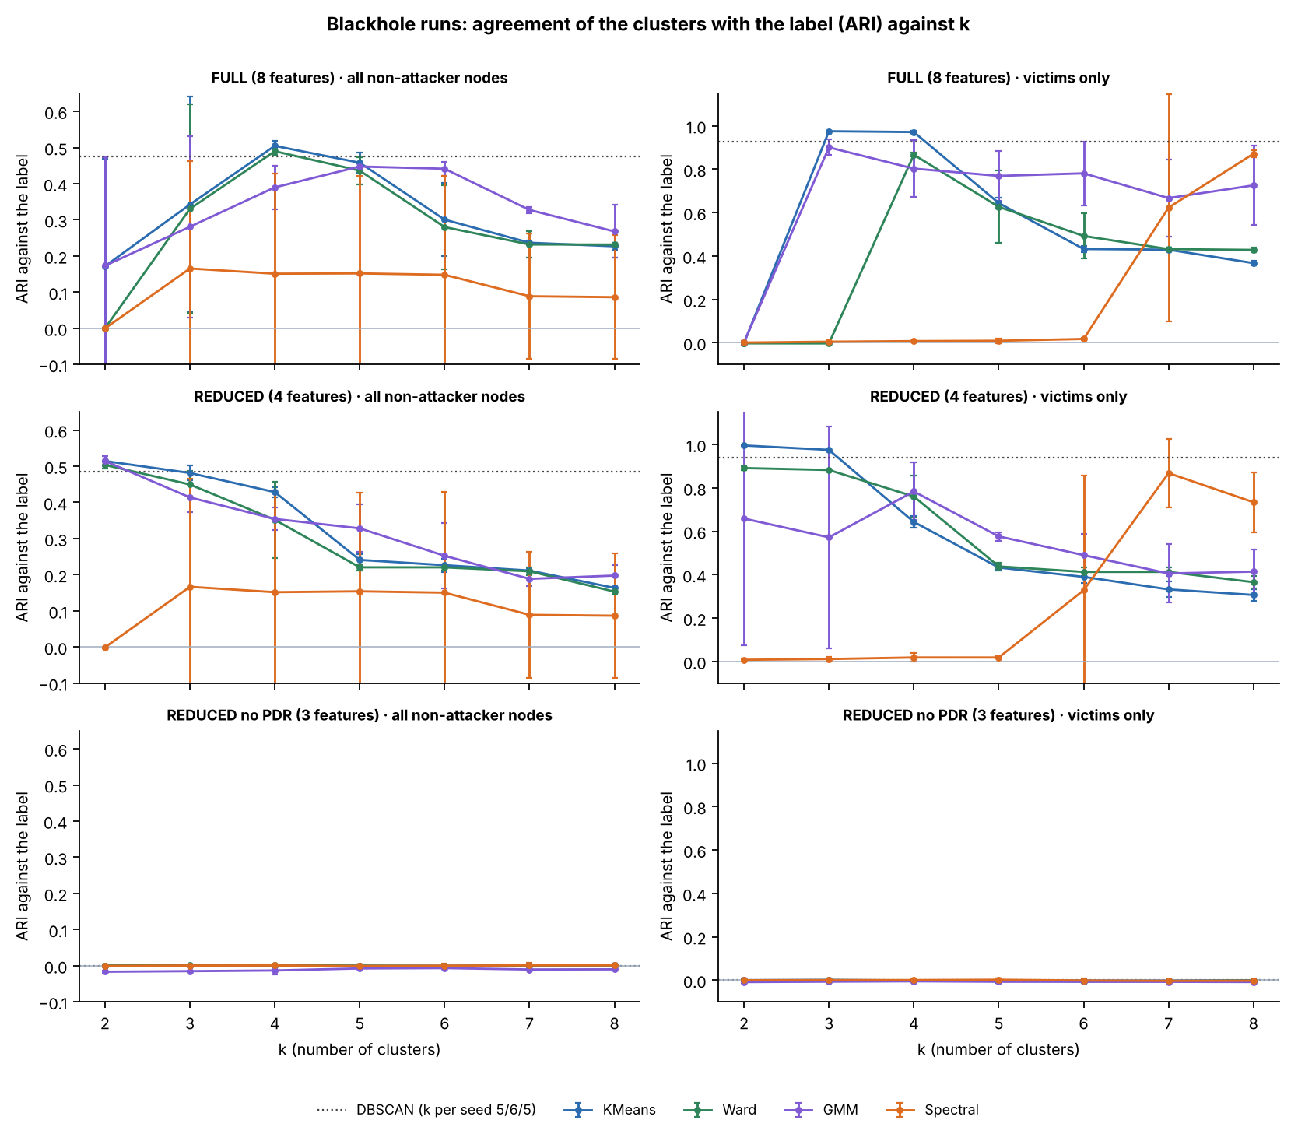
Figure 6.18: agreement with the label against k
How to read it
Axes
x = k (number of clusters), y = ARI. Rows = feature set; left = all non-attacker nodes, right = victims only.
Colours
One line per algorithm with ±1 SD over seeds; the dotted horizontal line is DBSCAN.
Look for
The bottom row (PDR removed) is flat at 0 for every algorithm and every k: PDR carries all the separation.
Number
K-Means, REDUCED, k = 2: 0.514 (all nodes), 0.996 (victims only).
Notes:
KEY FACTS
- Without PDR: ARI -0.016 to 0.002 for every algorithm and every k, on both populations
- Spectral clustering finds the attack on one seed and not on the others (large spread), so it is reported but not relied on
SOURCE: Section 6.4.2, Table 6.25, Figure 6.18

Slide 55
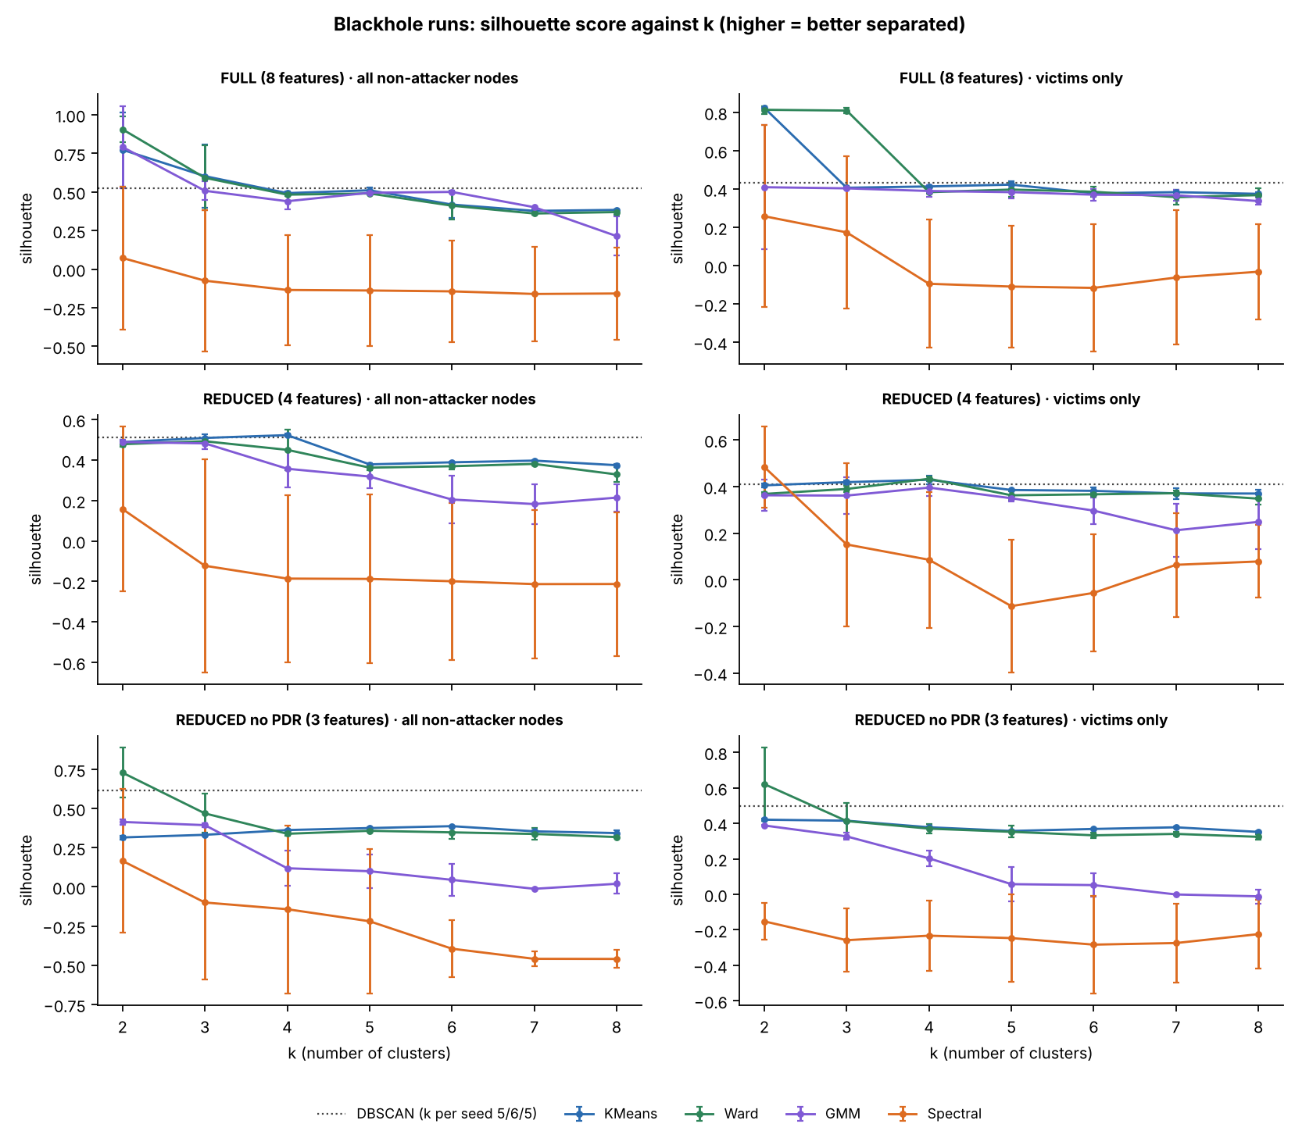
Figure 6.19: silhouette against k
How to read it
Axes
x = k; y = silhouette (higher = tighter clusters); rows and columns as in Figure 6.18.
Colours
One line per algorithm with ±1 SD over seeds; dotted = DBSCAN.
Look for
On FULL the silhouette peaks at k = 2 (K-Means 0.77, Ward 0.90), but that split is not the attack.
Number
K-Means ARI on that split: only 0.172.
Notes:
KEY FACTS
- Silhouette measures shape, not agreement with the label
- On seed 7 the small cluster was 44 windows of extreme RSSI variance; on seed 123 it was one window where a board changed parent
- The attack is recovered at k = 4 (K-Means 0.505)
SOURCE: Section 6.4.3, Figure 6.19

Slide 56
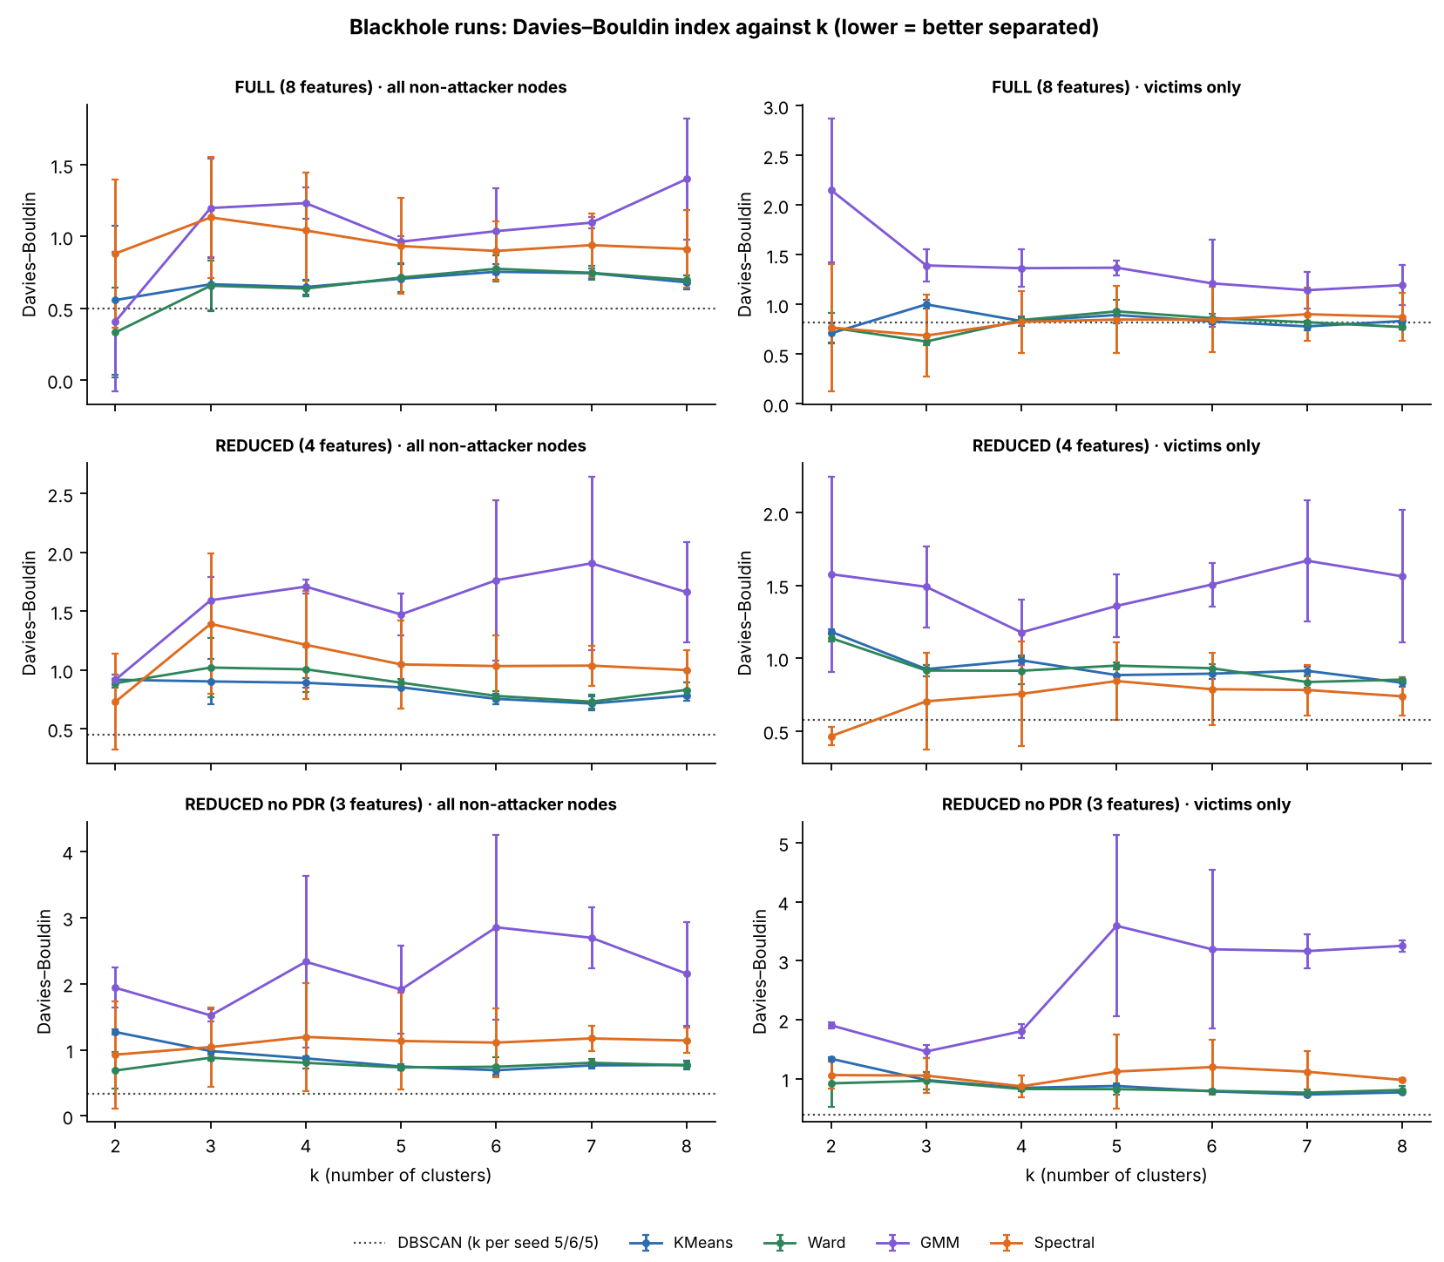
Figure 6.20: Davies–Bouldin index against k
How to read it
Axes
x = k; y = Davies–Bouldin index (lower = better separated); same layout as Figure 6.18.
Colours
One line per algorithm with ±1 SD over seeds; dotted = DBSCAN.
Look for
No single k stands out for every method, so k is chosen with the elbow, the silhouette and interpretability together.
Notes:
KEY FACTS
- Chapter 4 planned this combination of criteria; the silhouette alone picked a split that is not the attack
SOURCE: Section 6.4.3, Figure 6.20

Slide 57
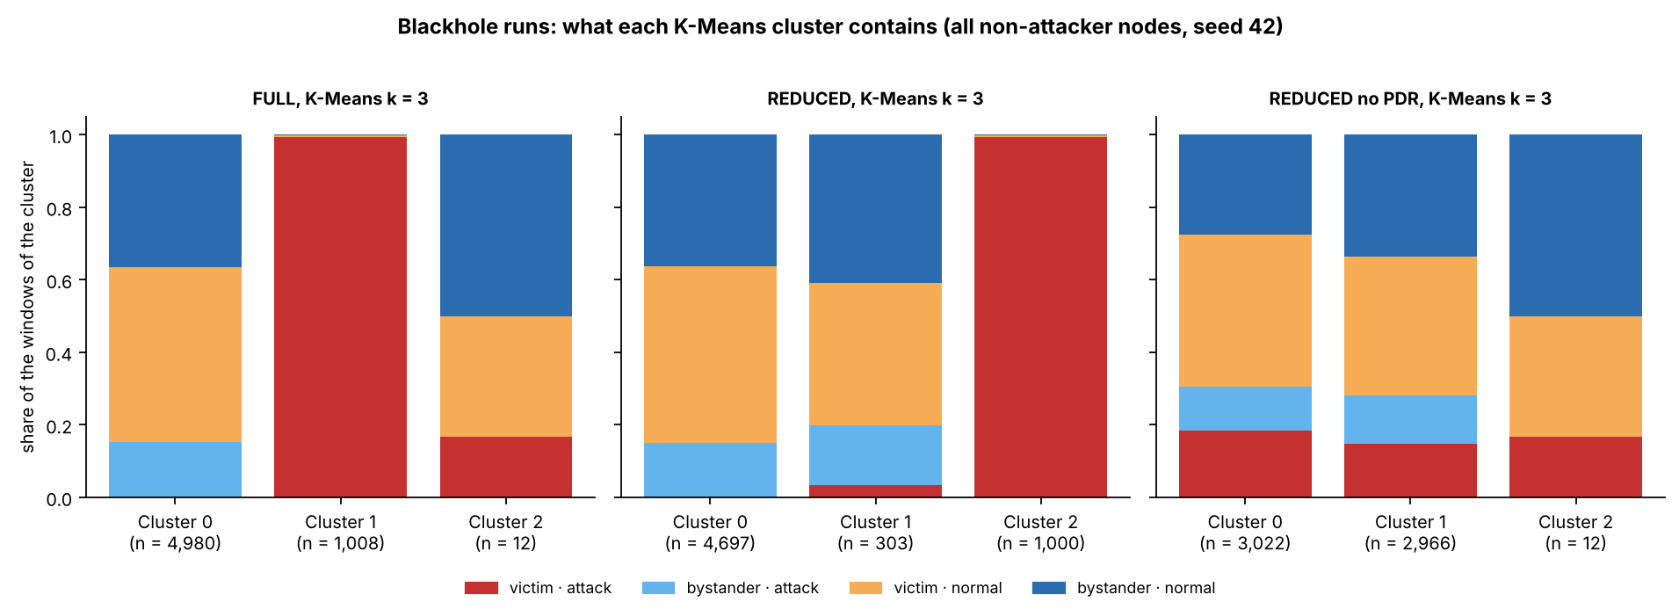
Figure 6.21: what each K-Means cluster contains
How to read it
Axes: Each bar = one cluster (n = windows) at k = 3; its height splits into the share from each group.
Colours: Red = victim attack, light blue = bystander attack, orange = victim normal, dark blue = bystander normal.
Look for: With PDR (FULL, REDUCED) one cluster is almost all red; without PDR no cluster is dominated by red.
Notes:
KEY FACTS
- FULL k = 3: clusters of 4,980, 1,008 and 12 windows; REDUCED: 4,697, 303 and 1,000
- The all-red cluster is the victims under attack, separated by PDR alone
SOURCE: Section 6.4.3, Figure 6.21

Slide 58
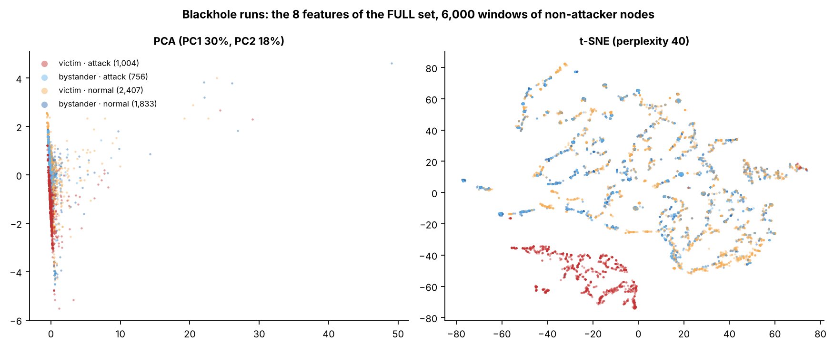
Figure 6.22: PCA and t-SNE, FULL set (blackhole)
How to read it
Axes: Left: PCA, PC1 30% and PC2 18% of the variance. Right: t-SNE, no units, only nearness counts.
Colours: Red = victim attack, light blue = bystander attack, orange = victim normal, blue = bystander normal.
Look for: In the t-SNE the red windows form their own island; the PCA is squashed by a few extreme RSSI-variance windows.
Notes:
KEY FACTS
- 6,000 windows of non-attacker nodes; legend counts: victim attack 1,004, bystander attack 756, victim normal 2,407, bystander normal 1,833
SOURCE: Section 6.4.3, Figure 6.22

Slide 59
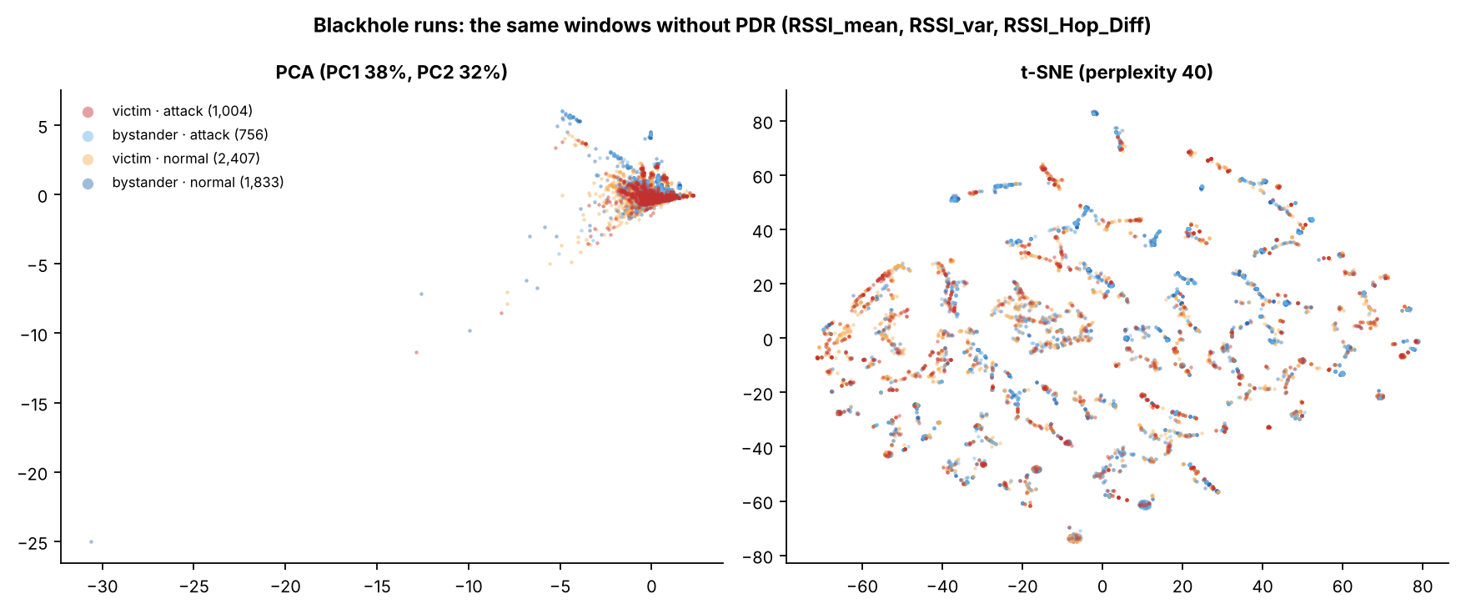
Figure 6.23: the same windows without PDR
How to read it
Axes: Left: PCA, PC1 38% and PC2 32%. Right: t-SNE. Only the three RSSI features are used.
Colours: Same colours as Figure 6.22.
Look for: All four colours sit on top of each other: without PDR there is no structure to find.
Notes:
KEY FACTS
- Features used: RSSI_mean, RSSI_var, RSSI_Hop_Diff
SOURCE: Section 6.4.3, Figure 6.23

Slide 60
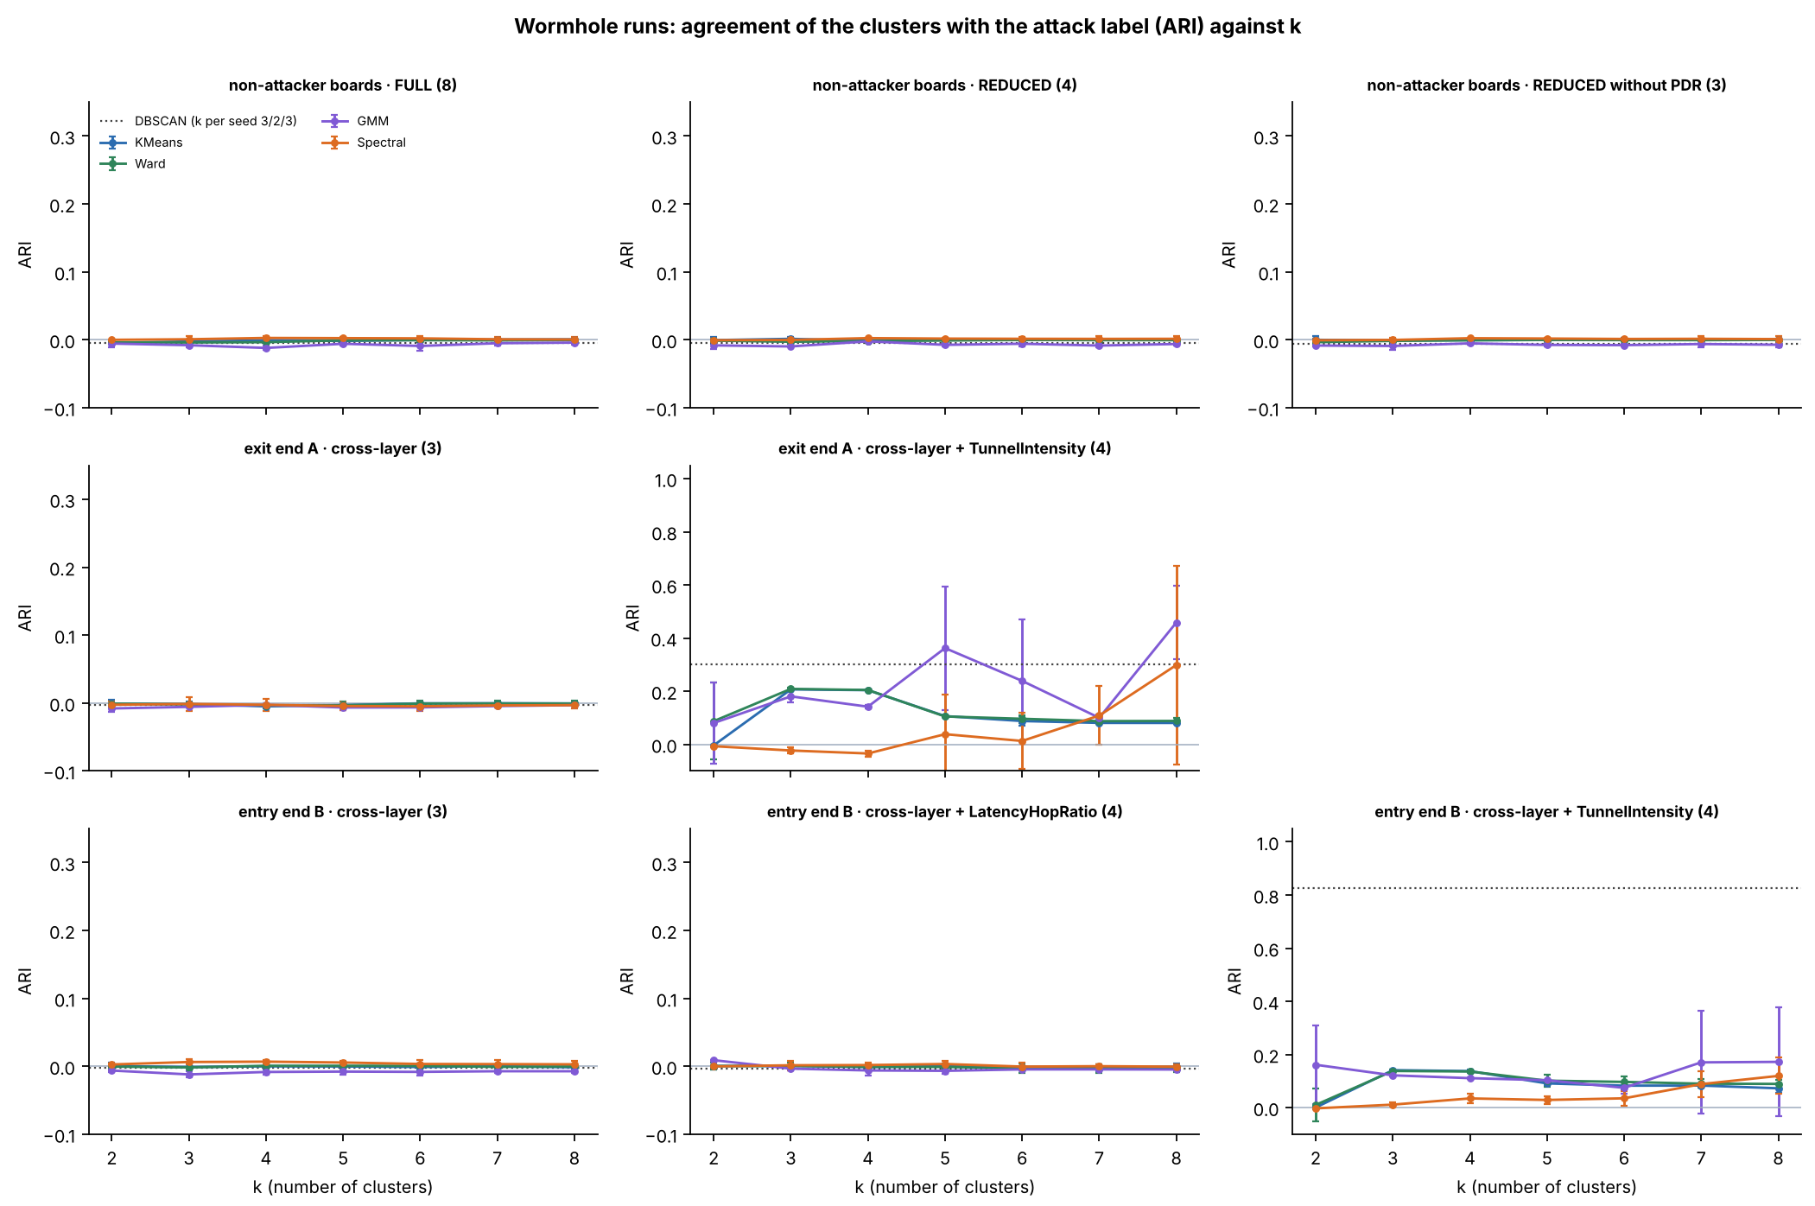
Figure 6.24: wormhole clustering against k
How to read it
Axes
x = k; y = ARI. One panel per board group and feature set; the y scale reaches 1.0 only where TunnelIntensity is added.
Colours
One line per algorithm with ±1 SD over seeds; dotted = DBSCAN.
Look for
Flat at 0 for the non-attacker boards and for cross-layer features alone; it rises only when TunnelIntensity is added.
Number
DBSCAN on end B with TunnelIntensity: ARI 0.827.
Notes:
KEY FACTS
- TunnelIntensity is excluded from model inputs by the leakage guard; it was added only as a diagnostic
- K-Means k = 2 on B gives ARI 0.000: it splits by signal level (-67.6 vs -47.1 dBm), not by tunnel activity
- Conclusion: the tunnel signal exists, but in the attackers' own counters, not in the cross-layer features
SOURCE: Section 6.4.6, Table 6.28, Figure 6.24

Slide 61
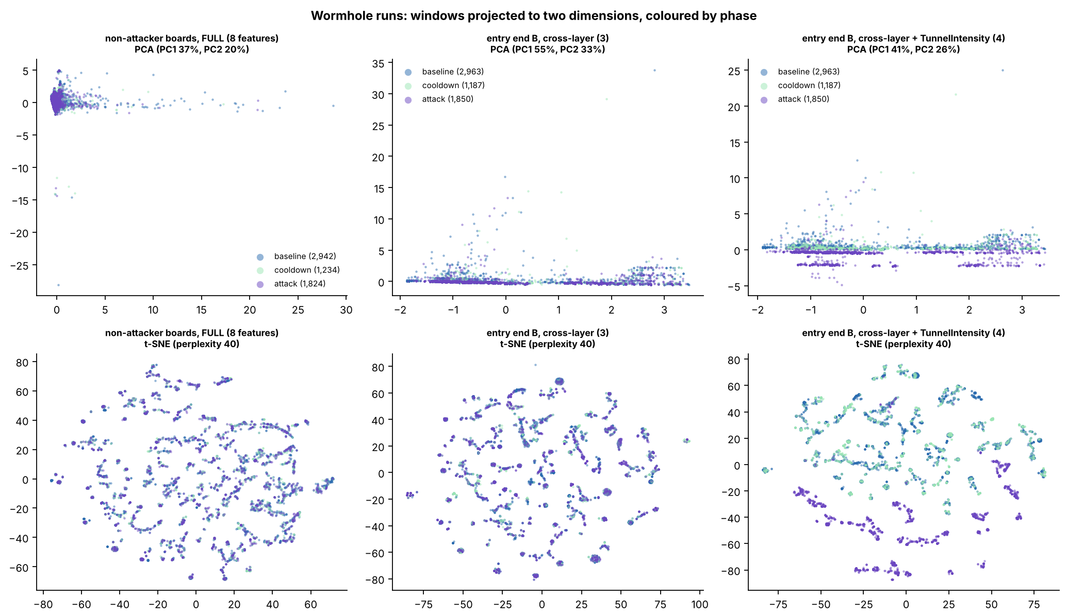
Figure 6.25: PCA and t-SNE of the wormhole runs
How to read it
Axes
Top row = PCA, bottom row = t-SNE. Columns: non-attacker boards, end B (cross-layer), end B plus TunnelIntensity.
Colours
Purple = attack windows; lighter colours = baseline and cooldown.
Look for
The first two columns overlap completely; in the third the attack windows split off, because TunnelIntensity is 0 in every normal window.
Notes:
KEY FACTS
- The split in the third column comes from a counter the attackers keep themselves, not from the radio or routing features
SOURCE: Section 6.4.6, Figure 6.25

Slide 62
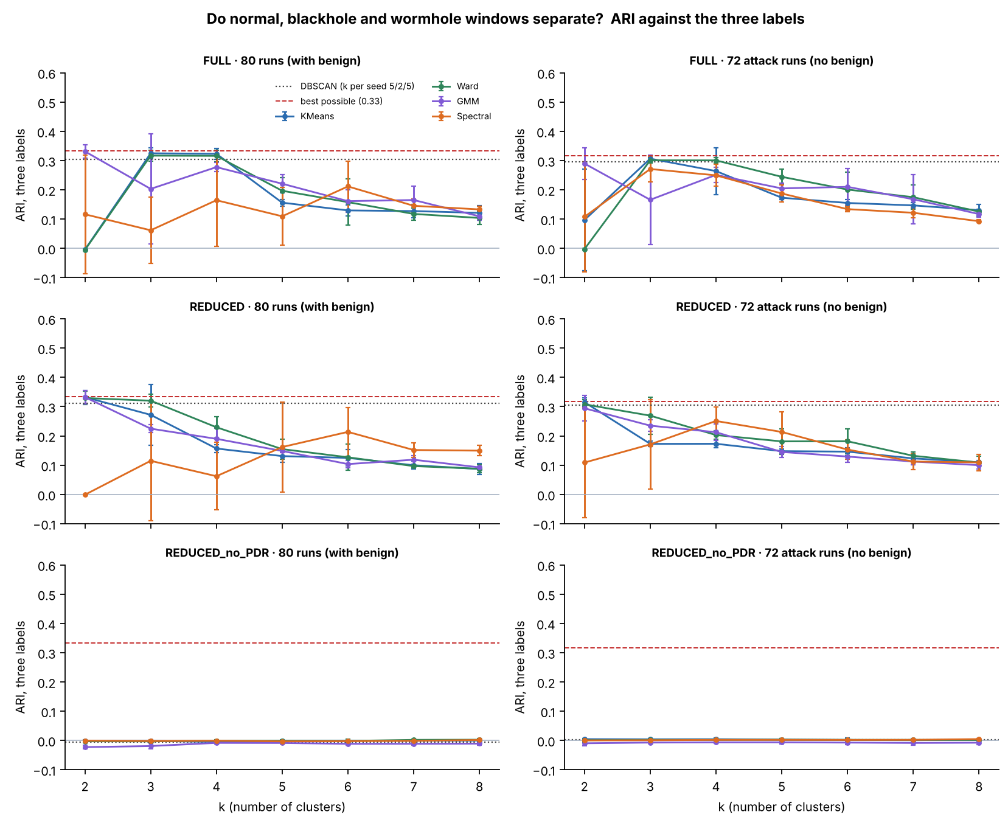
Figure 6.26: normal, blackhole and wormhole windows
How to read it
Axes
x = k; y = ARI against the three labels. Rows = feature set; columns = 80 runs (with benign) | 72 attack runs.
Colours
One line per algorithm with ±1 SD; red dashed = best possible score (0.33 and 0.32); dotted = DBSCAN.
Look for
K-Means reaches the red line at k = 2 or 3 and never goes above it; without PDR every line sits at 0.
Number
REDUCED, 80 runs: K-Means 0.333, best possible 0.334.
Notes:
KEY FACTS
- Best possible = victim attack windows vs. everything else: 0.334 (80 runs), 0.317 (72 attack runs), on the 6,000-window samples
- K-Means finds the blackhole victims and nothing else; the wormhole is not detected by the non-attacker features
SOURCE: Section 6.4.7, Table 6.32, Figure 6.26

Slide 63
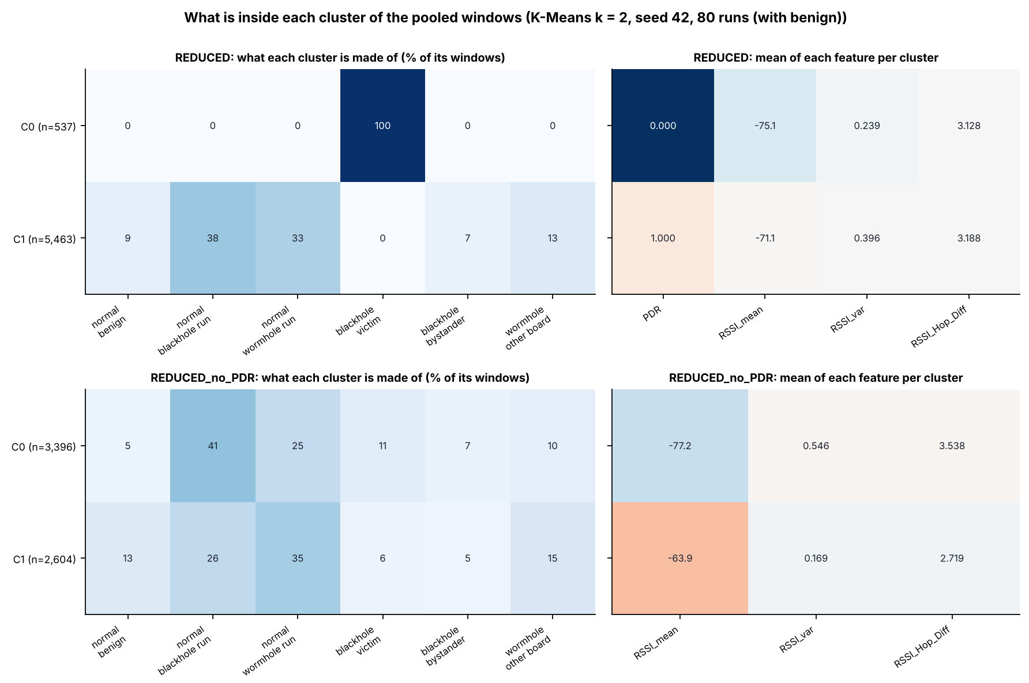
Figure 6.27: pooled clusters, K-Means k = 2
How to read it
Axes
Rows = clusters (n = windows). Left tiles: % of each cluster from each group. Right tiles: mean of each feature.
Colours
Darker blue = a larger share of the cluster; on the right each feature has its own colour scale.
Look for
REDUCED: cluster C0 (537 windows) is 100% blackhole victims with PDR 0.000; without PDR the clusters mix every group.
Notes:
KEY FACTS
- Groups: normal benign, normal blackhole run, normal wormhole run, blackhole victim, blackhole bystander, wormhole other board
- Pooled set: non-attacker boards of all 80 runs, 257,258 windows
SOURCE: Section 6.4.7, Figure 6.27

Slide 64
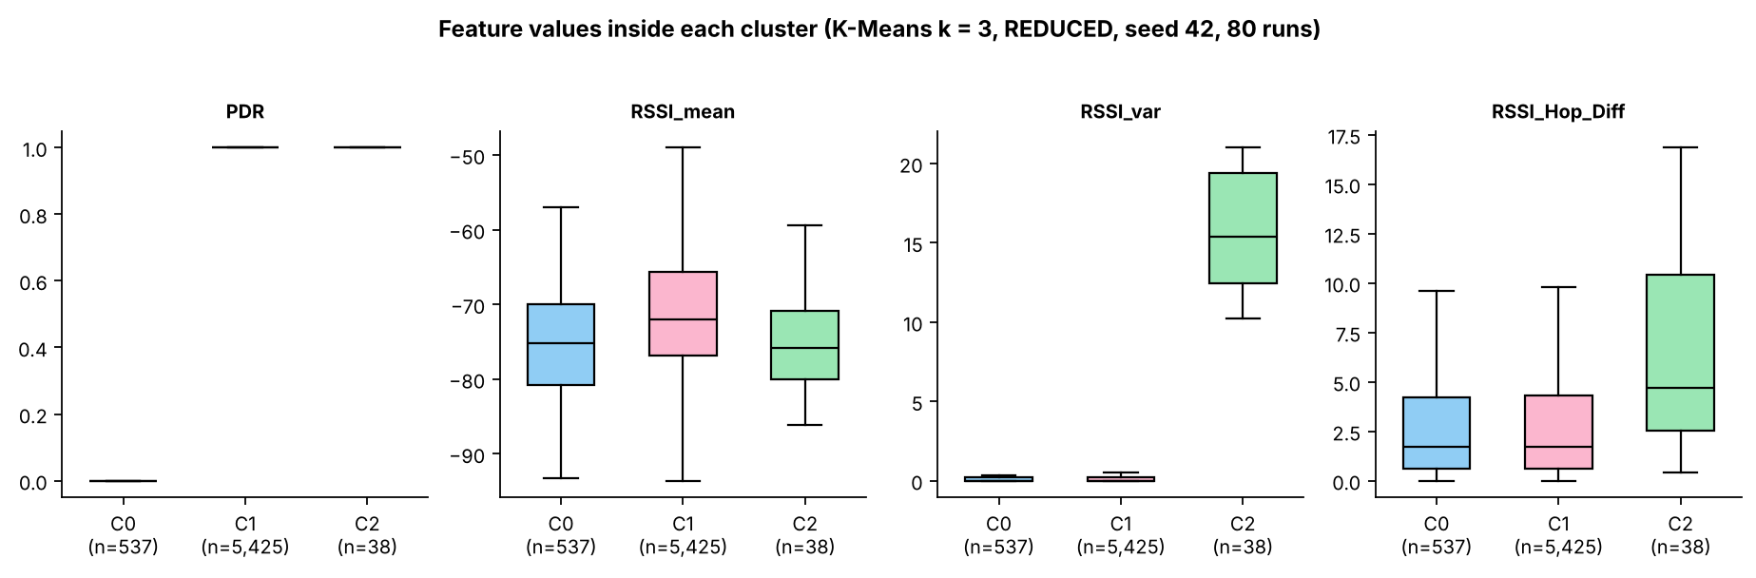
Figure 6.29: feature values inside each cluster
How to read it
Axes: One panel per feature; one box per cluster (C0, C1, C2) at k = 3, REDUCED set, with the number of windows.
Colours: Blue, pink, green = clusters C0, C1, C2; box = IQR, whiskers = 1.5 IQR.
Look for: C0 has PDR 0 (the victims); C2 (38 windows) is a small group with very high RSSI variance, not an attack.
Notes:
KEY FACTS
- n = 537, 5,425 and 38 windows
- C2 mixes every group (no victims), so it is a signal-variance outlier group
SOURCE: Section 6.4.7, Figure 6.29

Slide 65
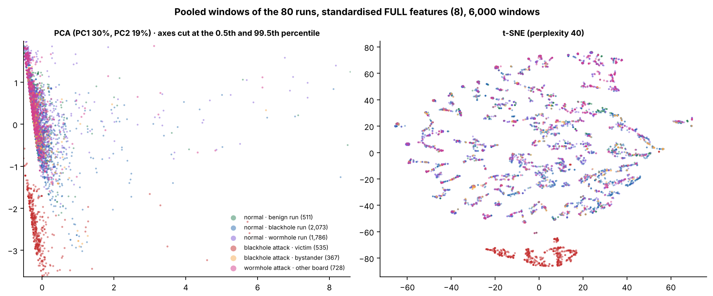
Figure 6.30: pooled 80 runs, FULL set
How to read it
Axes: Left: PCA (PC1 30%, PC2 19%), axes cut at the 0.5th and 99.5th percentile. Right: t-SNE (no units).
Colours: Six groups: normal (benign, blackhole run, wormhole run), blackhole (victim, bystander), wormhole other board.
Look for: Only the red group (victim attack windows) stands apart; the other five overlap, including the wormhole attack.
Notes:
KEY FACTS
- 6,000 sampled windows; legend counts in the figure
SOURCE: Section 6.4.7, Figure 6.30

Slide 66
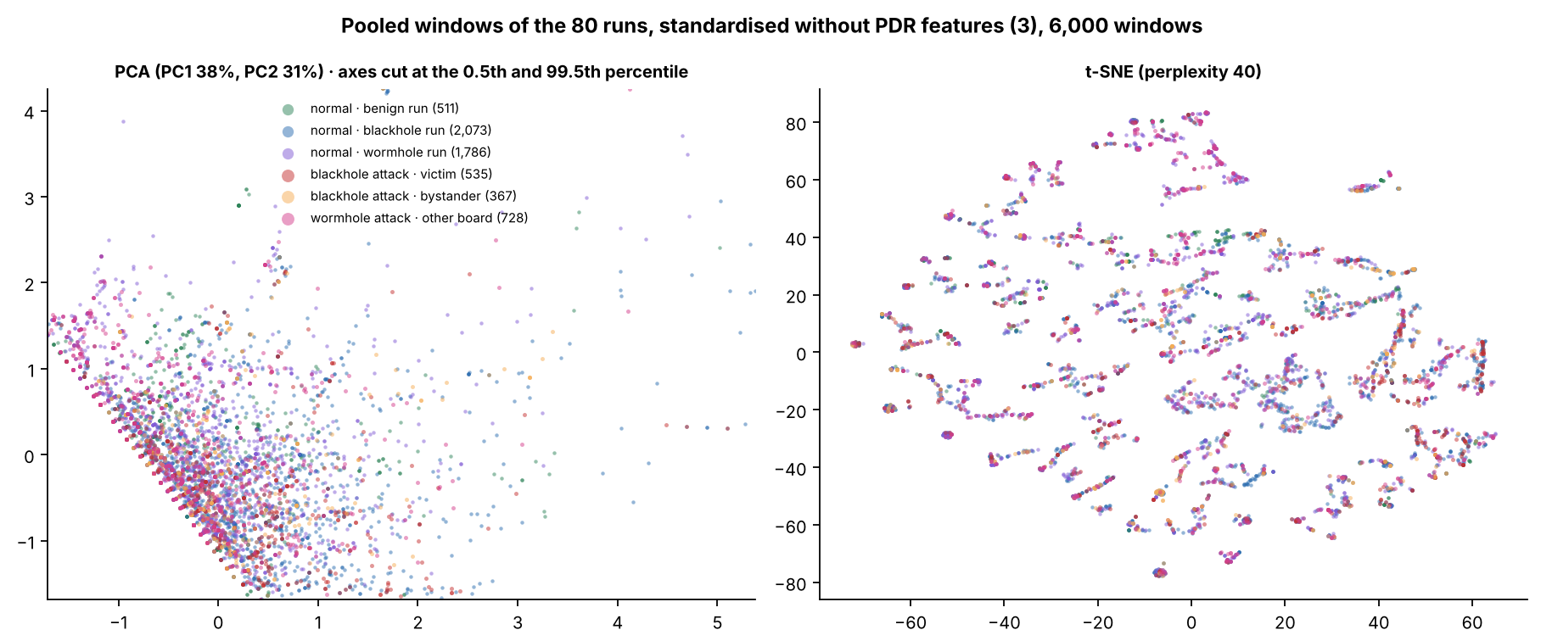
Figure 6.31: pooled 80 runs, PDR removed
How to read it
Axes: Left: PCA (PC1 38%, PC2 31%). Right: t-SNE. Only the three RSSI features are used.
Colours: The same six groups as Figure 6.30.
Look for: All six groups overlap: with PDR removed the pooled data show no structure at all.
Notes:
KEY FACTS
- Without PDR the pooled ARI is -0.023 to 0.005
SOURCE: Section 6.4.7, Figure 6.31

